Slide 1
Practical Messaging
A 101 guide to messaging
Ian Cooper
X, BlueSky and Hachyderm: ICooper

Slide 2
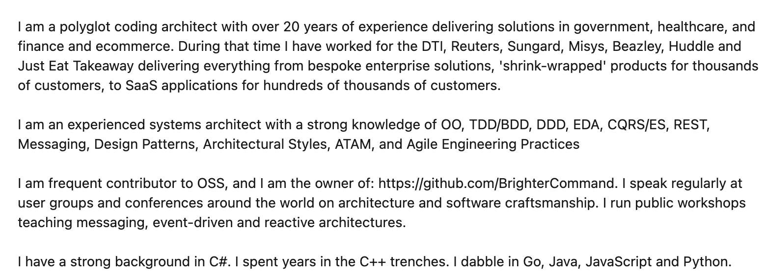
Who are you?
www.linkedin.com/in/ian-cooper-2b059b

Slide 3
Day One Messaging
Distribution
Integration Styles
Messaging Patterns
Queues and Streams
Managing Asynchronous Architectures

Slide 4
Day Two Conversations
Flow
Process Automation
Conversations

Slide 5
Day Two

Slide 6
Conversations

Slide 7
In & Out

Slide 8
Messaging Participants
A message has a header (metadata) and a body (data)
An application acts as either a requestor or provider
1.1 request()
:requestor
:provider
Prefer Requestor and Provider better than Producer/Consumer for conversation patterns because they indicate role.
A message is sent over a channel which is a virtual pipe i.e. topic, routing key
A channel is unidirectional (one way)
Notes:
The problem with using producer and consumer is that the consumer of the message might be the one exposing operations: i.e. receiving a command, or the producer of the API might be the one exposing operations i.e. sending a notification. By thinking instead about requestor and producer we make the role clearer => are you providing the API or using it.

Slide 9
Messaging Participants
Requestor: Registers a store and optimizes for a fast lookup on key search terms
Message indicating new store details
1.1 changedstore()
: Search
: Store Information
Provider:
Manages stores for our ecommerce site

Slide 10
In-Only (Fire and Forget)
Typically we call this fire-and-forget.
Under a In-Only pattern the requestor sends a request to the provider, but does not seek an acknowledgment of completion of the requested operation
1.1 request()
:requestor
:provider

Slide 11
In-Only (Fire and Forget)
Requestor: Has a paid for basket it wants to turn into an order
Typically fire and forget is used where we are finished with our part in a flow, and transferring control. We need no response as we are done..
1.1 place order()
:cashier
:order placement
Provider:
Raises an Order

Slide 12
Out-Only (Notification)
Under an Out-Only pattern the requestor subscribes to the provider, and an operation is triggered by receipt of a message but it does not acknowledge the message to the provider.
Typically we call this a notification.
1.1 notification()
:requestor
:provider

Slide 13
Out-Only (Publish-Subscribe)
Registers a store and optimizes for a fast lookup on key search terms
Notification indicating new store details
:Search
1.1 changedstore()
Registers all factors for determining if a store is open for business
:Store Information
Manages stores for our ecommerce site
:Availability
Out-Only is the Publish-Subscribe pattern; a producer is not aware of its consumers; the notification has loose coupling
:Pick-Up Locations
Registers where couriers may need to pick up and restrictions

Slide 14
In-Out (Request-Reaction)
Under an In-Out pattern the provider receives a request from the requestor on one channel, and returns a response from the operation triggered by that message on a separate channel.
1.1 request()
:requestor
:provider
1.2 reaction()
When using an In-Out pattern the provider sets a correlation id (conversation id) in the header of the request and the provider returns that id in the header of the response so that we can correlate replies sent over a separate channel.

Slide 15
Request-Reaction (Command-Acknowledgement)
Command: asking checkout for the operation to price a basket
Operation: Takes payment for the agreed amount and turns a basket into an order
Manages items for purchase by a customer of our ecommerce site
1.1 checkout()
:Basket
:Cashier
1.2 successfulpayment()
In-Out can support the Request-Response or Command-Acknowledgement pattern; a requestor triggers an operation on the provider and gets a response
Response: indicating the basket has been paid for
Notes:
it has behavioural (or control) coupling

Slide 16
In-Out (Query-Result)
Operation: Determines the delivery fee based on store and items in the basket
Manages items for purchase by a customer of our ecommerce site
Query asking for delivery fees for this basket
1.1 getdeliveryfees()
:Basket
:Delivery
1.2 deliverfee()
In-Out can support the Query-Result pattern; a requestor triggers a query on the provider and gets a result
Result indicating the fee for the current state of the basket
Notes:
it has behavioural (or control) coupling

Slide 17
In-Out (Subscribe-Notify)
Operation: Manages a list of subscribers
The requestor wants to subscribe to notifications
Subscription request
1.1 subscribe()
:requestor
:provider
1.2 confirm()
Query (optional) optionally we ask the requestor to confirm (note role switch!)
Start receiving Notifications
1.3 confirmed()
1.1 notification()
1.1 stop()
In-Out coupled with Out-Only can support a Subscribe-Notify pattern; a requestor requests to subscribe to a provider (start/stop)
Stop receiving Notifications
Notes:
it has behavioural (or control) coupling

Slide 18
Blocking In-Out (Request-Reply)
The requestor provides a unique Reply To channel (in the request message header/metadata) and the provider uses that channel for the response, allowing the sender to look up the suspended workflow. A correlation id is thus not required
In order to resume, we need a way to identify the suspended workflow.
1.1 request()
:requestor
:provider
1.2 reaction()
The requestor may block on the Reply To channel whilst awaiting the reply.

Slide 19
Out-In (Solicit-Response)
Under an Out-In pattern a provider solicits a response from a subscriber, and await a confirmation
1.1 solicit()
:requestor
:provider
1.2 response()
Under an Out-In pattern the subscriber confirms receipt of the provider’s solicitation

Slide 20
Out-In (Solicit-Response)
Query to see if a courier is available to receive orders for delivery; usually Delivery service will follow with notifications of available work.
Delivery service assigns delivery request to drivers
1.1 solicit()
:Courier
:Delivery
1.2 ready()
Courier offers jobs depending on location and busyness

Slide 21
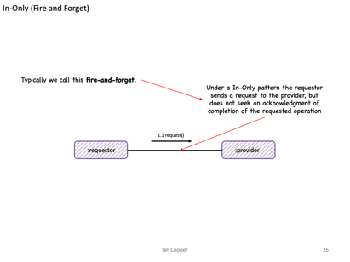
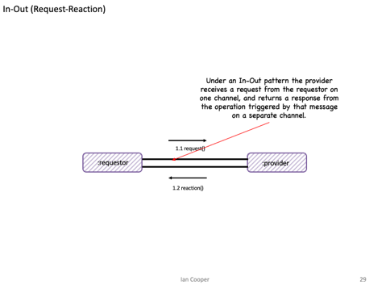
In-Only (fire and forget)
Messaging
Has Intent
Request An Answer (Query)
Transfer of Control
(Command)
Transfer of Value
Part of a Workflow
Part of a Conversation
In-Out (request-reaction)
Concerned with the Future

Slide 22
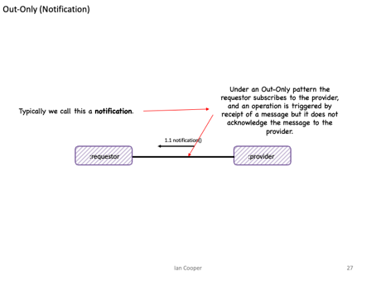
Eventing
Out-Only (notification)
Provides Facts
Things you Report On
No Expectations
History
Context
Concerned with the Past

Slide 23
Repair and Clarification

Slide 24
Repair and Clarification
The requestor triggers an operation on the provider by sending it a message
We need to consider the possibility of a fault being triggered by the operation triggered by the message.
1.1 request()
:requestor
:provider
What guarantees does the provider make to the requestor about communicating any faults that are triggered?

Slide 25
No Fault
From the requestor’s perspective, faults are an application issue for the provider, and not its concern
1.1 request()
:requestor
:provider
Under a No Fault pattern the provider makes no attempt to communicate triggered faults from the operation to the requestor

Slide 26
No Fault
Most likely we fix consistency issues out-of-band via logs or error reports.
1.1 changedstore()
: Store Information
:Search
We make no attempt to indicate to Store Information that we cannot add a store to our search results
Notes:
This is “good enough” in many cases.

Slide 27
Message Triggers Fault (Robust In-Only)
Assumption here is that the requestor can take action on receipt of the fault; but does not normally take a response.
Under Message Triggers Fault pattern a provider propagates triggered faults from the operation back to the requestor that triggered the operation via a message
1.1 request()
:requestor
:provider
1.2 fault()
The message must have the opposite direction and go back to the requestor
Notes:
The key here is that there is no existing subsequent message to replace with a fault, but we still want to communicate faults back

Slide 28
Message Triggers Fault
If Order Placement cannot place the order due to a fault we may raise an error
1.1 place order()
:cashier
:order placement
1.2 fault()
The requestor does not need to acknowledge success, but on a fault may need to take other action such as a refund

Slide 29
Fault Replaces Message
Under the Fault Replaces Message pattern a provider propagates faults triggered by an operation by switching to a fault flow, replacing any message subsequent to the first with a fault.
1.1 request()
:requestor
:provider
1.2 fault()
1.2 reaction()
The requestor can handle the error; the error replaces the existing response
Notes:
The key to understanding this is that any message in the conversation, between these two components, after the first, may indicate a fault instead of the normal outcome

Slide 30
Fault Replaces Message (Robust In-Out)
Assumption here is that the pricer can orchestrate a new flow, such as asking for an alternate payment method, or cancel the order.
Under Fault Replaces Message pattern the payment provider would signal errors taking a card payment back to the pricer
1.14* take payment()
:pricer
:payment provider
1.5 payment error()
The message should indicate why the payment failed. This might be an issue with the payment provider but it also might be an issue like an invalid card or insufficient funds

Slide 31

In-Out-Retry
The requestor may not receive an expected response from a provider. What can it do?
The requestor can set a timeout within which to receive a response.
1.1 greet()
:requestor
:provider
1.2 greet()
1.3 acknowledge()
The requestor can choose to retry if it does not receive a response within that time window.
Because we might send a message twice, the operation on the consumer must be idempotent, or the consumer must de-duplicate already seen messages

Slide 32
Tentative Operations
The requestor may not know if the provider will be able to succeed, and might not want to proceed without knowing that
The requestor asks if the operation is possible, and reserves the resources to perform it.
The provider reserves the resource – usually with a timeout – during which time it awaits a message to commit or rollback
:requestor
1.1 reserve()
:provider
1.2 reservation()
1.3 commit()
1.4 acknowledge()
1.3 rollback()
1.4 freed()
If the requestor completes its work, it then commits to ask the provider to allocate the reserved capacity.
If the requestor fails, it then rolls back to ask the provider to free the reserved capacity.

Slide 33
Tentative Operations
We don’t want to purchase the item if the stock is not available
The basket asks the warehouse if there is stock, and if so reserves it. Fault could replace message here, if the item is out-of-stock
The warehouse reserves the stock – with a timeout (so others can purchase if we don’t) – during which time it awaits a message to commit or rollback
:basket
1.1 reserve()
:warehouse
1.2 reservation()
1.3 commit()
1.4 acknowledge()
1.3 rollback()
1.4 freed()
If the customer finishes shopping and pays for the basket before the time limit, then it commits to ask the warehouse to allocate the stock.
If the basket does not complete, then it rolls back to ask the warehouse to free the stock.

Slide 34
Fat & Skinny

Slide 35
Fat Message
The resulting document message may be large (Claim Check can help here)
The requestor provides all external the information that the provider needs to act
1.1 request()
:requestor
:provider
With a Fat Message the requestor sends across all the external information a provider may need to perform the operation.

Slide 36
Fat Message Example
The requestor provides the delivery and pickup address, size, weights etc of the order
The resulting message contains delivery and pickup address, size, weights etc of the order
1.1 request()
:order fulfilment
:courier assignment

Slide 37
Fat Message, Transitive Dependencies
Purchase Order Message
OrderId | Customer First Name | Customer Last Name | Customer Post Code | Restaurant Name | Restaurant Post Code | Order Amount | Order items
12345 | Jo | Doe | SW17 3NJ | Pizza ‘R Us | SW17 5HK | 1038p | …
This data has a lifetime of the message i.e. the purchase order and their schema changes if the purchase order changes
This data is a transitive dependency, it has a lifetime of the Customer and their schema changes if the Customer schema changes – which may force us to change the message for Customer changes
This data is a transitive dependency, it has a lifetime of the Restaurant and their schema changes if the Restaurant schema changes – which may force us to change the message for Restaurant changes

Slide 38
Skinny Message
The requestor provides only information unique to that event, assumes provider has or can obtain other information required
The resulting notification message is normally skinny
1.1 request()
:requestor
:provider
With a Skinny Message the requestor assumes the provider has necessary external information to perform the operation.

Slide 39
Skinny Request, Example
Courier assignment needs information that is not on the order: weights, addresses. It has to source that from elsewhere
The requestor provides a notification that there is an order, but only inlines data that is unique to the order not reference data like weights or addresses
1.1 request()
:order notification
:courier assignment

Slide 40
Skinny Message, Normalized
Purchase Order Message
Customer
OrderId | Order Amount | Order items | CustomerId | RestaurantId
12345 | 1038p | …
Customer First Name | Customer Last Name | Customer Post Code
Jo | Doe | SW17 3NJ
Restaurant
We use an Id where the data does not share the lifetime of the message; we assume the requestor obtains the data out-of-band
Restaurant Name | Restaurant Post Code
Pizza ‘R Us | SW17 5HK
We need to lookup this id with other providers

Slide 41
Skinny Message using Reference Data
Data that leaves Provider B via an API is Reference Data.
It is:
- Immutable
-Versioned
-Stale
It can be cached locally to provider A to prevent the need for frequent lookups
The requestor provides only information unique to that event, assumes provider A has or can obtain information from provider B
1.1 request()
:requestor
:provider A
:provider B
1.2 cache looup()
With a Skinny Message the requestor assumes provider A B has a local cache of data from provider B that it can use to look up identifiers in the Skinny Message.
:entityState
:cacheState V1
Database

Slide 42
Skinny Message via REST/RPC
On a cache miss we request the data from provider B, and store it in the cache. The cache is choosing Availability over Consistency, except on a miss.
The requestor provides only information unique to that event, assumes provider A has or can obtain information from provider B
1.1 request()
1.3 request()
:requestor
:provider A
:provider B
1.4 reply()
1.2 cache lookup()
1.5 cache write()
In CAP theorem, this is choosing Consistency over Availability as it means Provider A’s uptime is that of A & B. If B fails, A fails.
We lookup the missing data in a local cache of reference data.
We may indicate both the identity and version of the information we expect the provider to hold.
:entityState
:cacheState V1
Database

Slide 43
Skinny Message, Reference Data via ECST (Event Carried State Transfer)
The downstream provider subscribes to these notifications and writes these to the local cache.
In CAP Theorem we choose Availability over Consistency – we choose to accept stale data over accepting the risk of failure due to a Partition.
The requestor provides only information unique to that event, assumes provider A has or can obtain information from provider B
1.3 request()
:requestor
:provider A
:provider B
1.4 cache looup()
1.2 cache write()
1.1 notification()
The upstream provider raises a notification when the state of entities its own changes – out-only or pub-sub
We lookup the missing data in a local cache of reference data.
We may indicate both the identity and version of the information we expect the provider to hold.
:entityState
:cacheState V1
Database

Slide 44
Skinny Message using Reference Data
Order Fulfilment does not include address details for the restaurant for pickup, instead we assume that courier assignment has obtained it from restaurant information
1.1 request()
:order fulfilment
:courier Assignment
:restaurant Information
1.2 cache looup()
We lookup the restaurant in the local cache by id and version.
If we have the restaurant, but not the version, we can apply backpressure and retry the order after a delay
::couriers
:restaurantCache V1
Database

Slide 45
Domain, Summary & Sequence

Slide 46
Domain or Delta Event
The resulting message is usually a past participle named after the command that caused the change i.e. BasketItemRemoved, BasketItemAdded
An approach to Pub-Sub where the provider communicates granular state changes to its requestors
1.1 event()
:requestor
:provider
With a Domain or Delta Event, the provider cannot use a DataType Channel as the domain events for the observable must be ordered on the same channel, and have a different schema.
This puts an additional burden on the requestor to multiplex handling of the event

Slide 47
Summary or Snapshot Event
The resulting message is versioned and contains metadata describing the cause(s) of any changes. It is usually named after the observable in the pub-sub i.e. BasketChanged
An approach to Pub-Sub where the provider communicates a summary of state changes to its requestors
1.1 summary()
:requestor
:provider
With a Summary or Snapshot Event the provider can use a DataType Channel, as there is just one schema used to communicate a snapshot of the observable.

Slide 48

If Later, Stream
Reads record. Discards v2 of 12345 as is “earlier” than V3 which was already applied
Reads record. Handles v1 of 12345
98765: v2
12345: v2
98765: v1
12345: v3
12345: v1
:producer
:consumer
Reads record. Handles v3 of 12345. Is “later” than V1 so is applied
If Later allows us to use a versioned Summary Event to ignore ordering errors. Even on a stream, a non-blocking retry or guaranteed delivery via an outbox may result in out-of-order messages. We can also shed load
We cannot use If Later with a Domain Event, as they all must be applied. We can only use a blocking retry with a Domain Event and cannot shed load.
Notes:
An easier option is to publish not deltas but complete new versions of the upstream change, that can be applied to replace everything downstream. We can then apply the rule of ‘write if later’ in other words if we have v0, we can write v2 even if we do not see v1 because v2 is later and either overwrites or include v1 changes. We can then safely discard v1 changes.

Slide 49
If Later, Queue
Locks message. Expects v1 of 12345
:consumer
98765: v2
12345: v3
98765: v1
12345: v2
12345: v1
:producer
Read Past
Locks message. Writes v2 of 12345
:consumer
If later allows message to processed be out-of-order with a queue and competing consumers. A queue normally processes messages, and not events, so this only applied where we are using a queue.
If a message must be ordered, such as a series of commands, we must use requeue with delay, or a sequencer to re-order.
Notes:
An easier option is to publish not deltas but complete new versions of the upstream change, that can be applied to replace everything downstream. We can then apply the rule of ‘write if later’ in other words if we have v0, we can write v2 even if we do not see v1 because v2 is later and either overwrites or include v1 changes. We can then safely discard v1 changes.

Slide 50
Public and Private Providers
The resulting message is versioned and contains metadata describing the cause(s) of any changes.
1.1 event()
:provider
1.3 summary()
:requestor
:provider
:provider
1.1 event()
An approach to Pub-Sub where a public provider communicates with collaborators in other domains via a summary event of domain events from private providers

Slide 51
Flow

Slide 52
Paper Workflows
“My life looked good on paper - where, in fact, almost all of it was being lived.” - Martin Amis

Slide 53
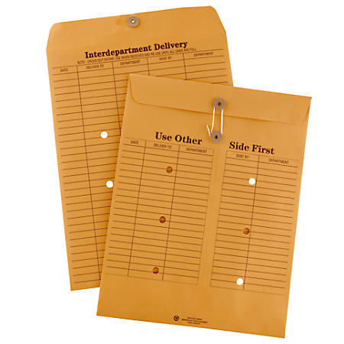

Messaging/Discrete Event
Series Event (Document)
Discrete, Immediately Actioned
Series, Supports Action
Skinny
Fat

Slide 54

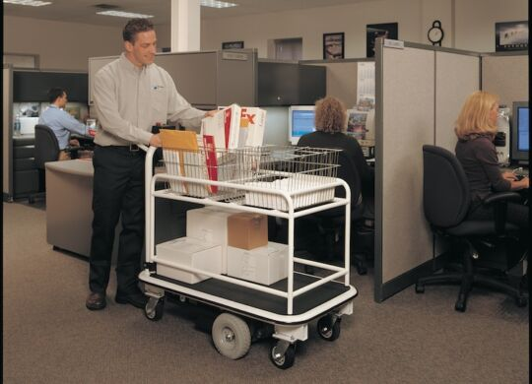

Slide 55
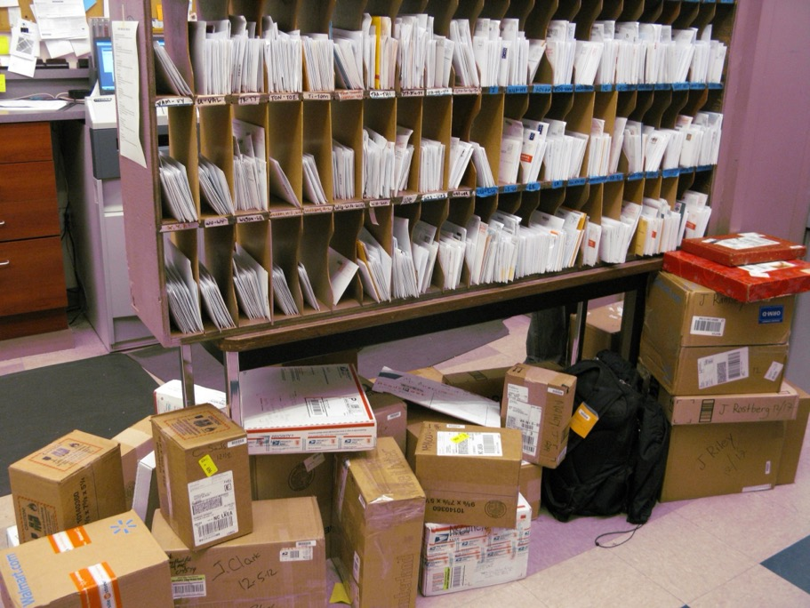
Notes:
When I worked in a mail room, this was called ‘the frame’ and it was how we sorted mail by floor, that was then delivered by a worker with a cart. In essence this is what a broker does. Creates channels, that you send messages to that are delivered to subscribers.

Slide 56
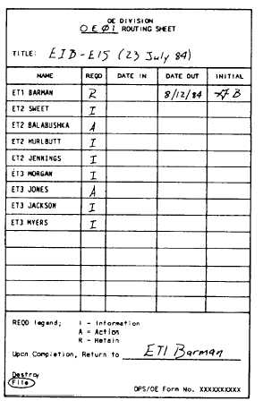

Slide 57
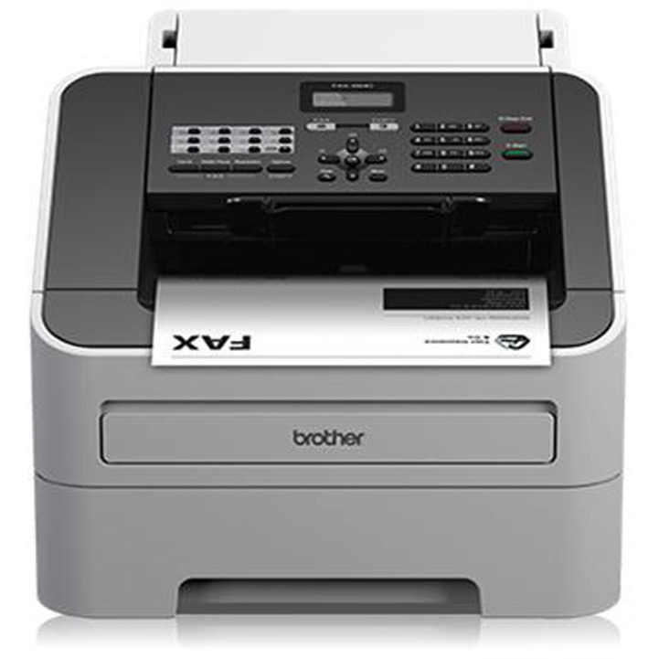

Slide 58
What is a microservice?
SOA is focused on business processes. These processes are performed in different steps (also called activities or tasks) on different systems. The primary goal of a service is to represent a “natural” step of business functionality. That is, according to the domain for which it’s provided, a service should represent a self-contained functionality that corresponds to a real-world business activity.
Josuttis, Nicolai M.. SOA in Practice: The Art of Distributed System Design . O'Reilly Media. Kindle Edition.
Notes:
Whilst this is SOA advice, we are taking the view that microservices are just SOA 3.0, and as such, most of the best practice still applies
The key here is to understand that we want service alignment with a business process or activity. Whilst services offer us benefits such as fault-tolerance through isolation, that is not the thrust of this workstream. Instead this workstream is looking at how microservices improve our productivity, when we get alignment between a service and a business process.
We amplify this point in the next slide, which talks about the entity service anti-pattern

Slide 59
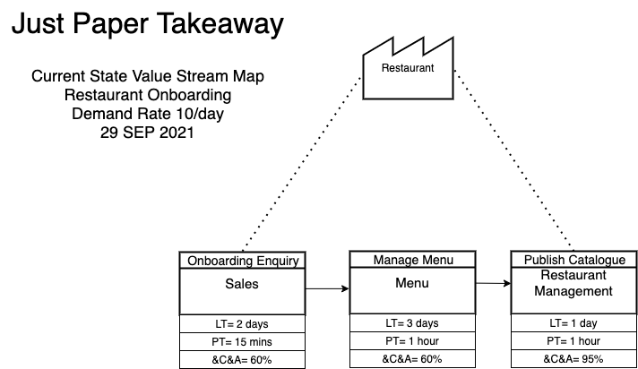

Slide 60
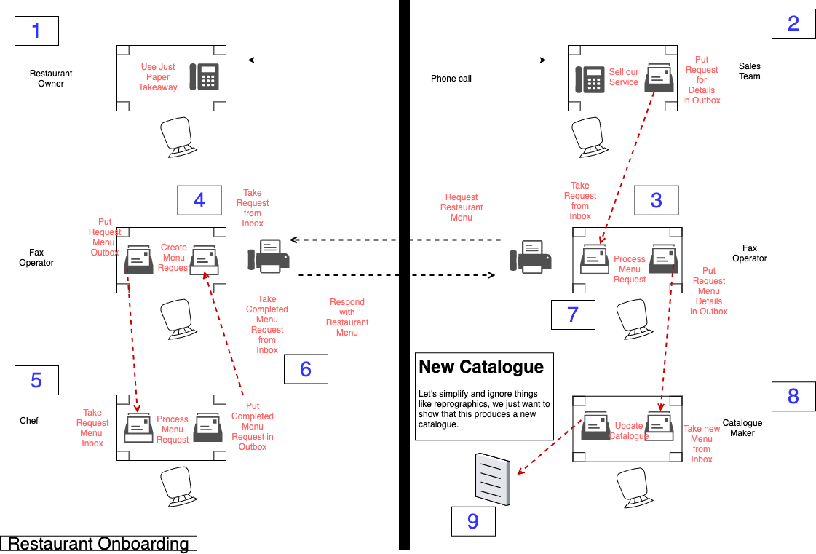

Slide 61
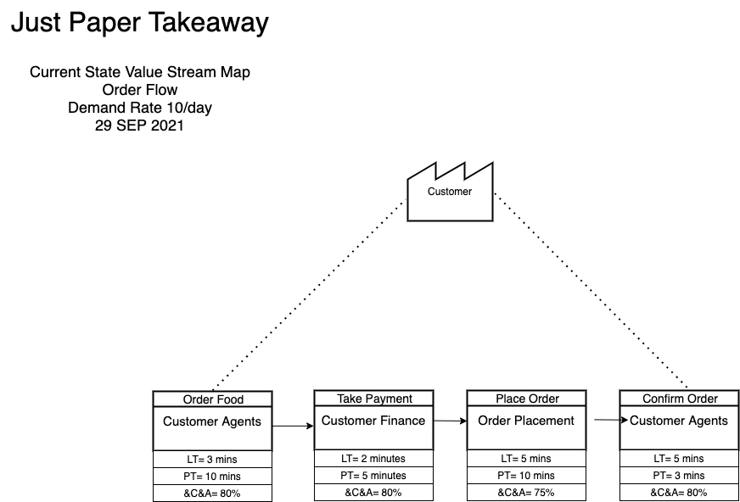

Slide 62
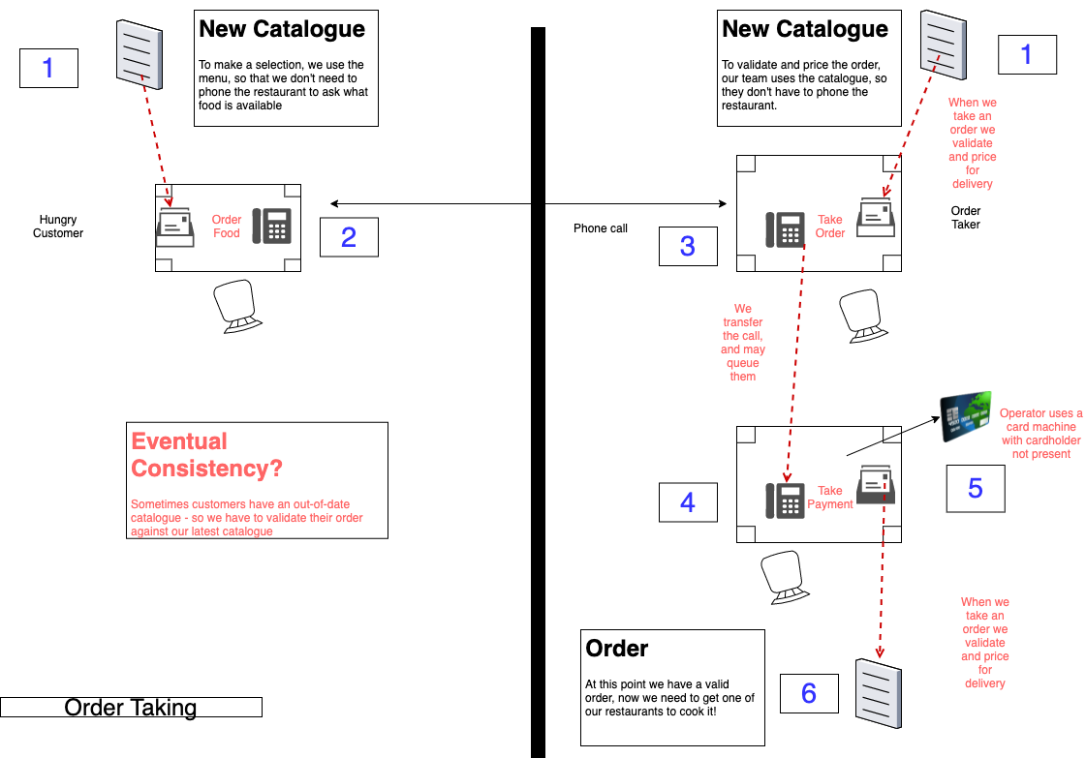

Slide 63
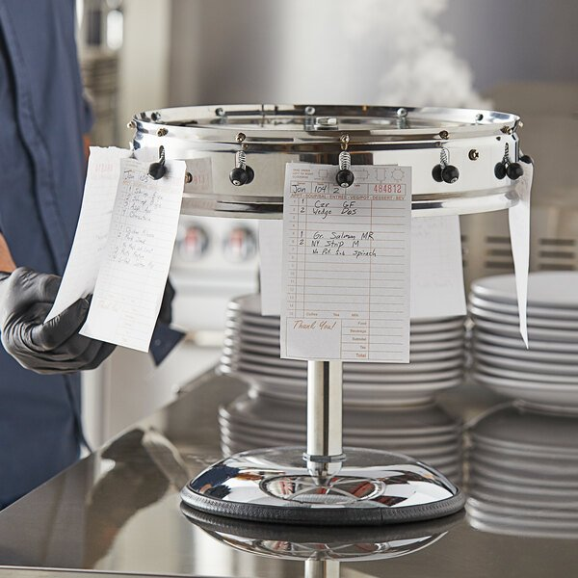
Order Wheel
Notes:
In a restaurant an order wheel is a piece of equipment used to track customer orders. It is used to facilitate a process whereby a new order is clipped onto a wheel which is then turned clockwise from the server or "waitress" side of the restaurant around to the kitchen or "cook" side. Orders are made in sequence and turned further back around to the server as completed.

Slide 64
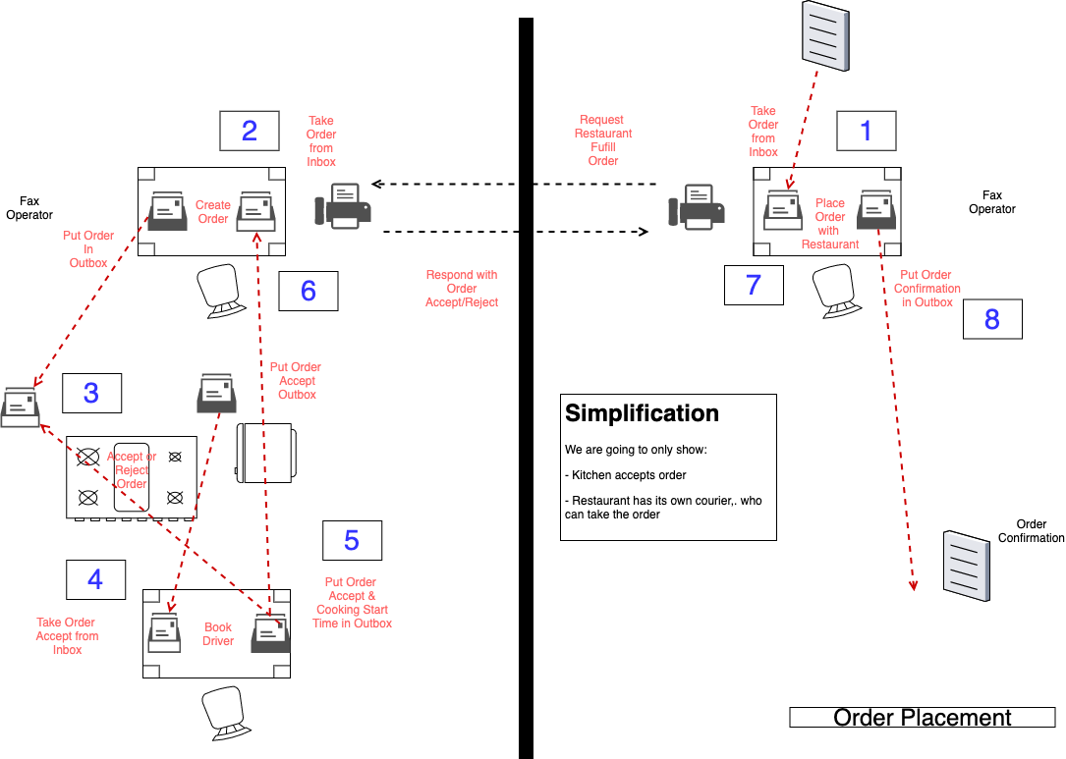

Slide 65
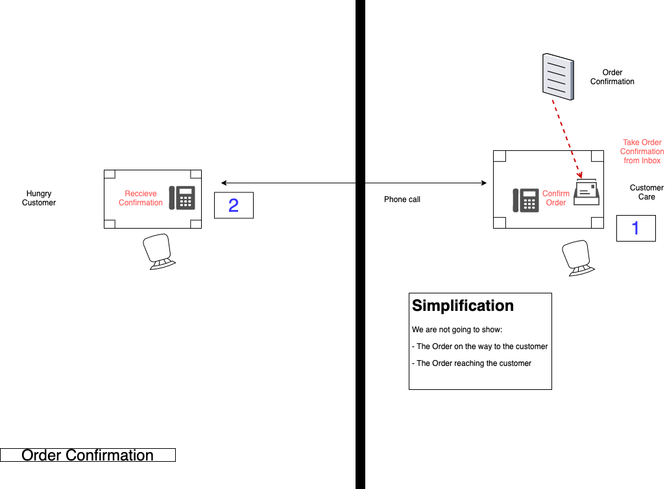

Slide 66
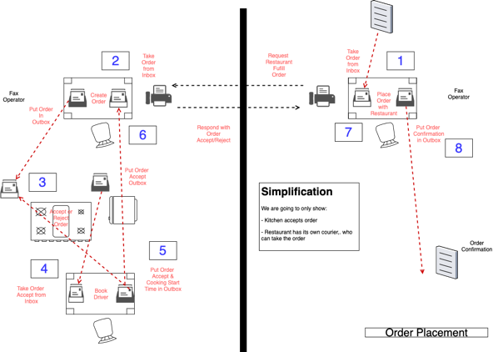
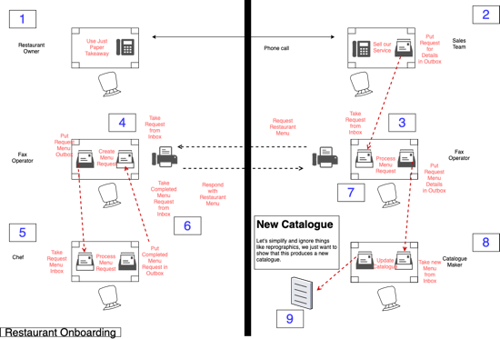
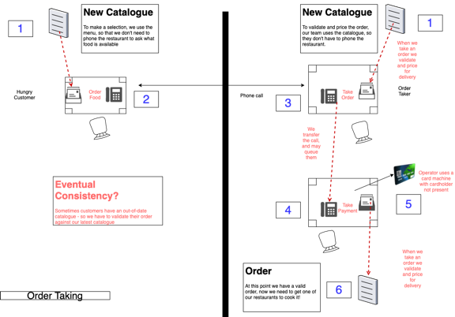
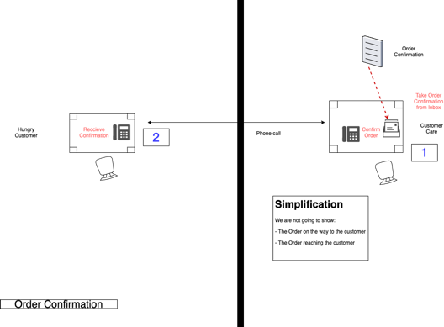

Slide 67
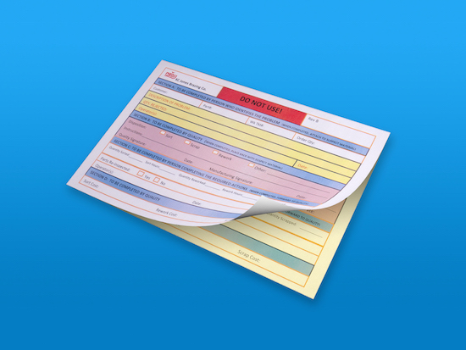
Notes:
This is a carbon copy memo – when you write on it, the pressure creates a copy in the carbon paper underneath, it was used to ensure that you had a copy of any message that you sent. You could also look through the message history on a file to understand the current state of a file.

Slide 68
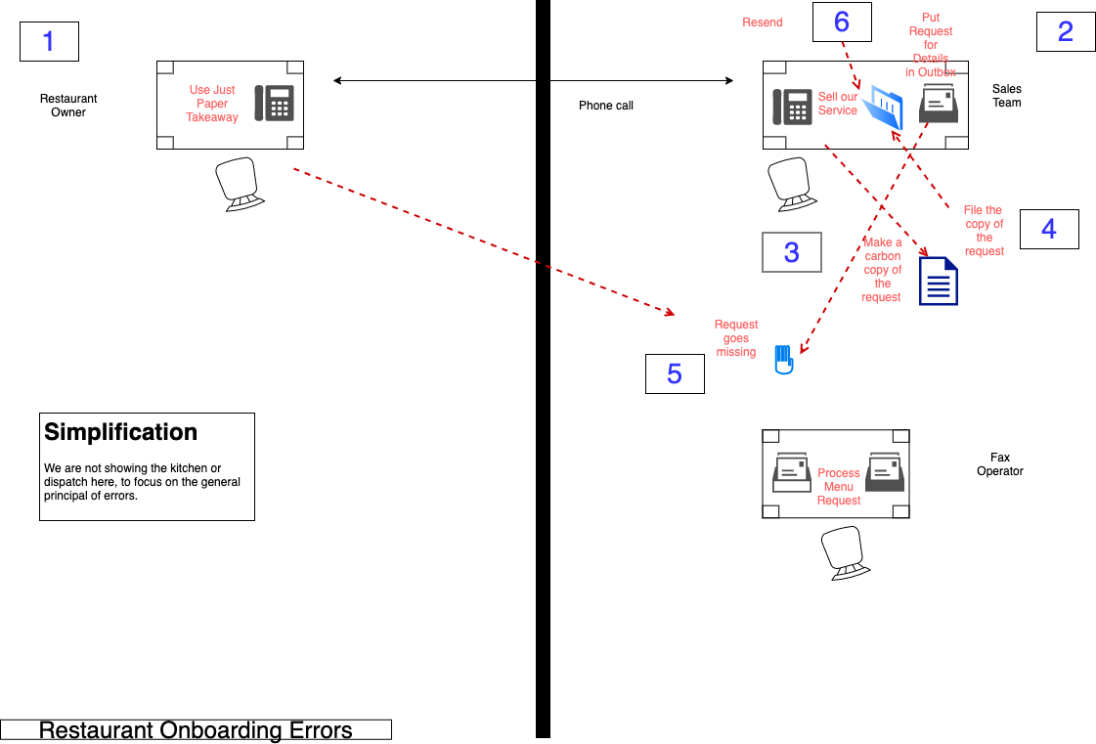

Slide 69
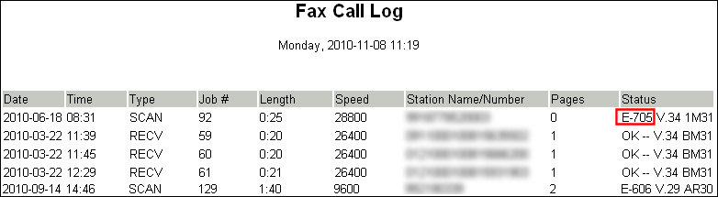
Notes:
How do we deal with errors

Slide 70
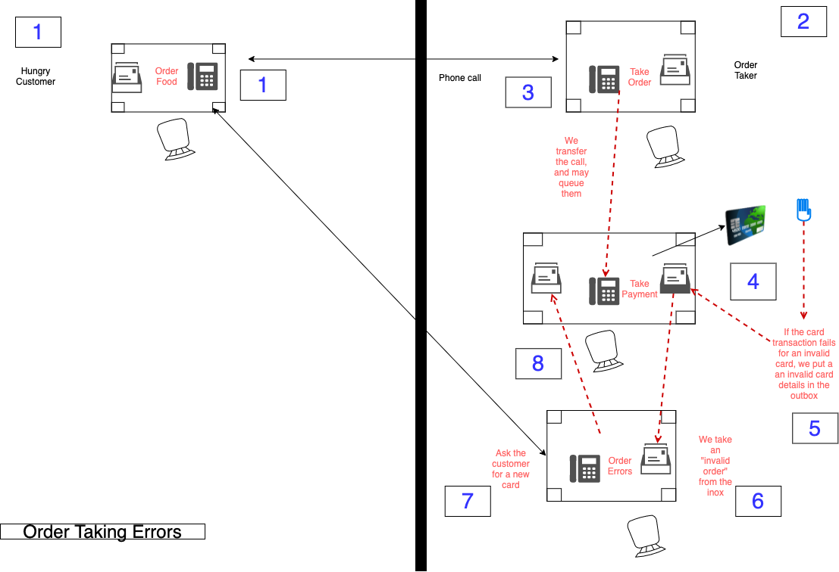

Slide 71
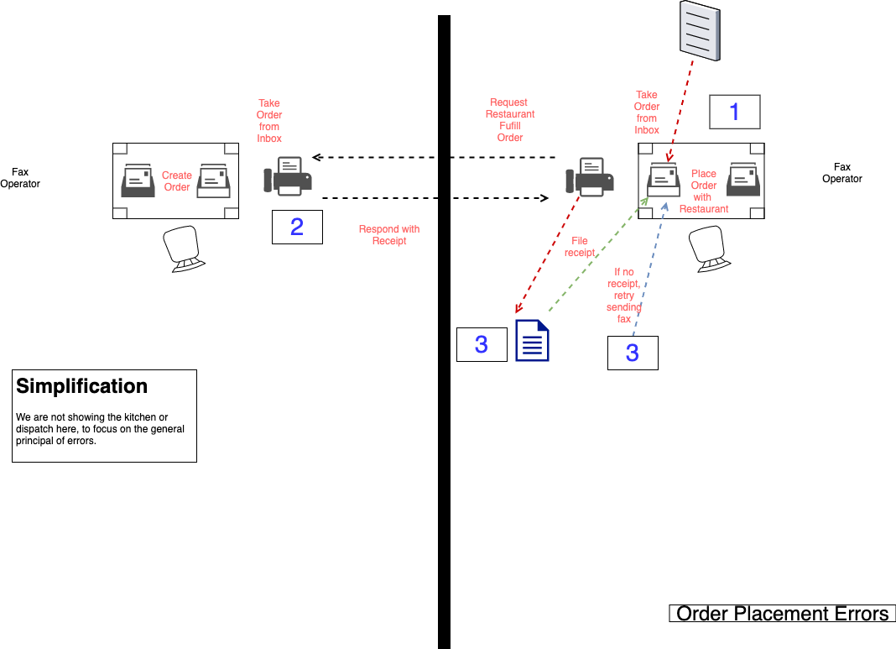

Slide 72
Reactive programming

Slide 73
Object Oriented Programming

Slide 74
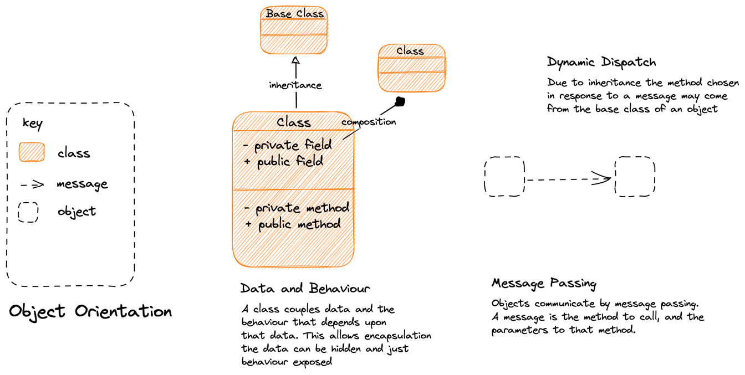
Notes:
Object Orientation
==============
A class has a role, with attendant responsibilities
We capture those responsibilities as behaviors
We encapsulate the data that those behaviors need within the object
Roles may be inherited via dynamic dispatch.

Slide 75
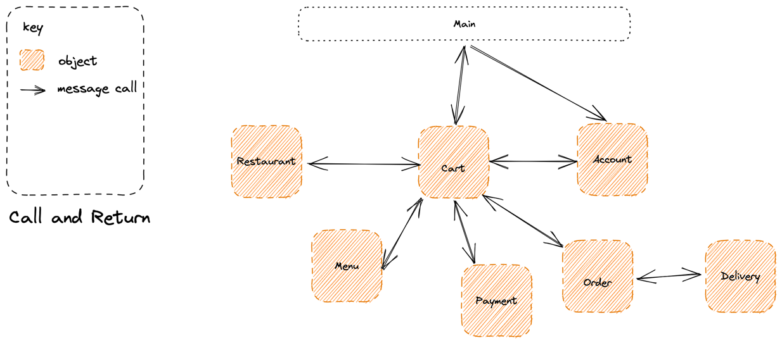
Call and Return: The main method represents our entry point and it uses message passing to invoke objects, which in turn invoke other objects, and return to their caller
God Object: A danger here is that we end up with a ”god” object, such as Cart here, that controls all the other objects. This is a high-degree of behavioral coupling
Notes:
A system passes control to meet a use case between different classes with roles in the system, via message passing
This is a “call and return” approach i.e. main on down

Slide 76
Data Flow Programming

Slide 77
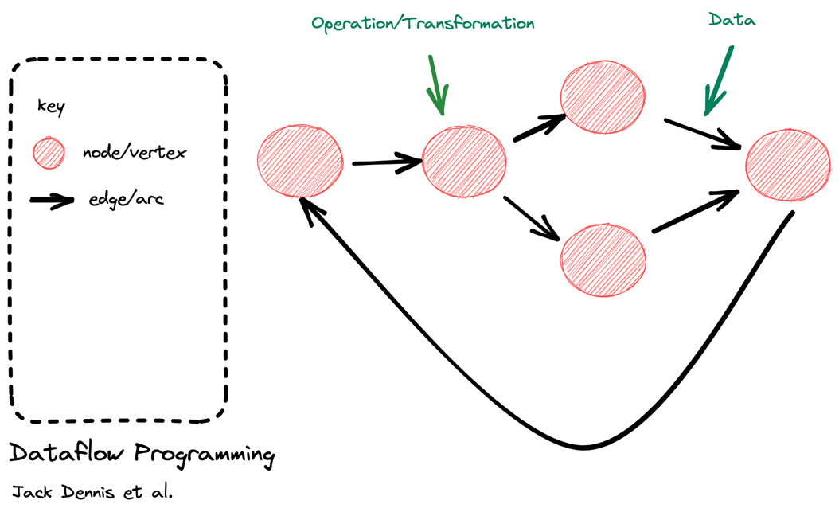
Data Flow Programming conceptualizes a program as a directed graph where operations are represented as nodes which are connected via arcs through which data flows. A node performs an operation when input data is available.
Notes:
Dataflow programming perhaps oldest expression of reactive approach.
Unlike OO where state is co-located in nodes with the behavior that acts upon that state, in dataflow programming data moves between transformations (nodes) via arcs (links).
Example: Unix CLI programming, pipes and filters etc.

Slide 78
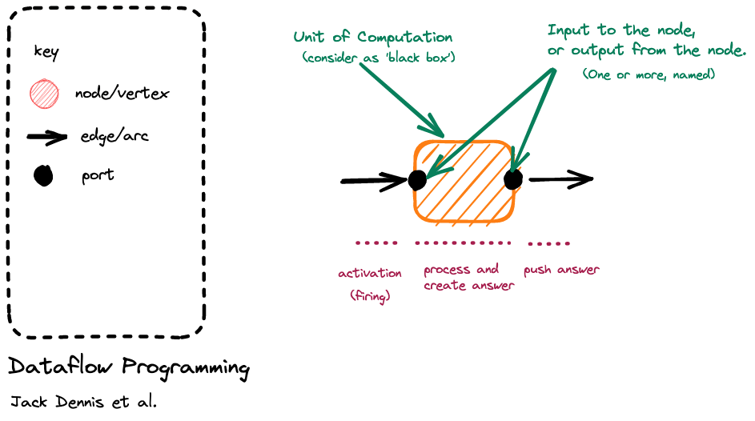
Notes:
Breaking it down, we have a node with an input port, it is activated or fired when an event arrives on the input port arc; it responds to that event with some computation; as it is a ’black box’ it signals what happened by raising an event on an output port (to which others may react)
It is reactive because it fires up in response to an event being raised
Generally a node is single threaded.

Slide 79
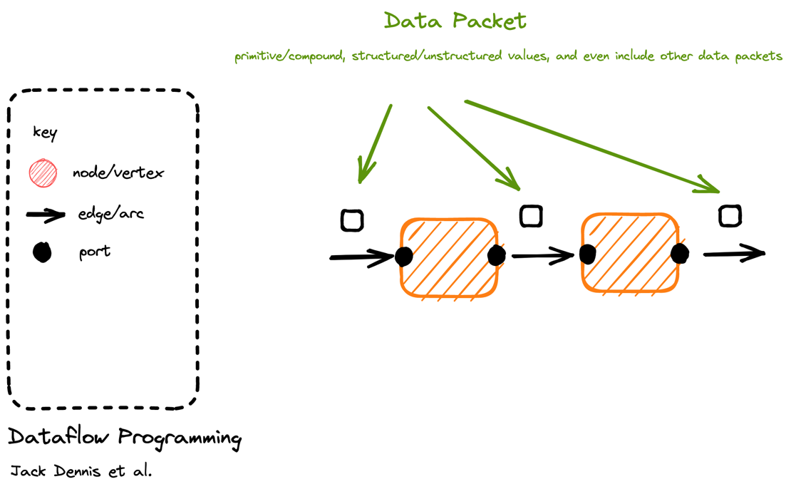
Notes:
No special requirements about packets, they are just data

Slide 80
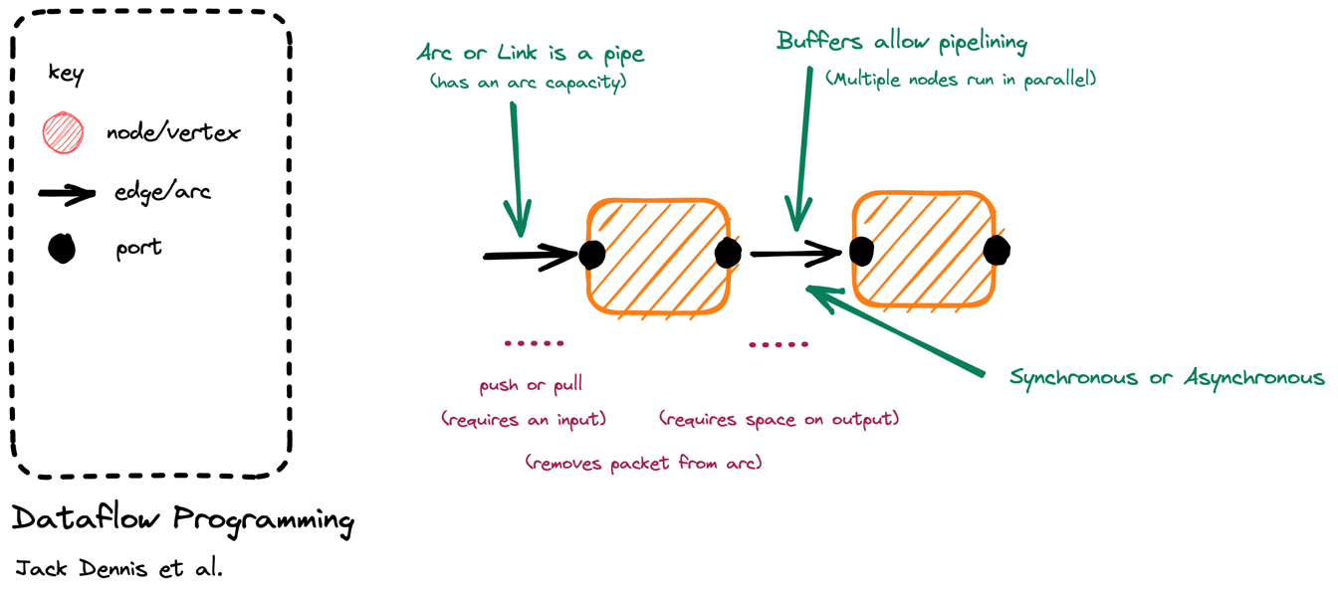
Node Lifetime: In ‘classic’ dataflow programming the lifetime of a node is from activation when there is work to do (push) or work is requested (pull) until it has pushed the answer.
Capacity: In dataflow programming we do not activate a node to read from the input, if there is no space on the output. (Infinite capacity links exist only in theory). This creates backpressure.
Notes:
Arc or links connect nodes
If the link is buffered it means that we can be asynchronous – raise our output event on to the buffer even if the downstream component is currently reacting to an earlier event. This allows us to parallelize, though throughput is limited to the slowest node
But for dataflow this is not a requirement, we may build a synchronous pipeline that has no buffering between components i.e. is single threaded
May be push => source is generating events (hot) like a mouse click and we ‘listen’ to them
May be pull => until we ask for events, by firing up a sink that pulls the chain of nodes, nothing is generated
If a buffer is full, we can’t output to it => this creates backpressure or load shedding

Slide 81
Flow Based Programming
“Everything Flows and Nothing Stays.” - Heraclitus

Slide 82
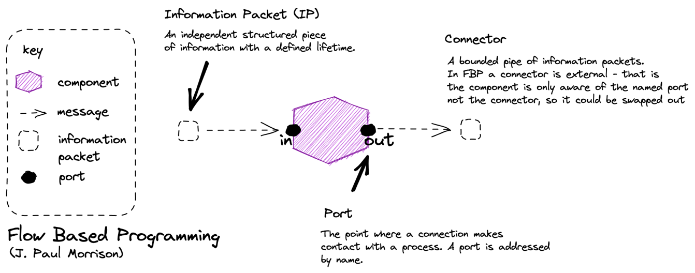
Flow-Based Programming (FBP) is a subclass of DFP. While DFP can be synchronous or asynchronous, FBP is always asynchronous. FBP allows multiple input ports, has bounded buffers and applies back pressure when buffers fill up.

Slide 83
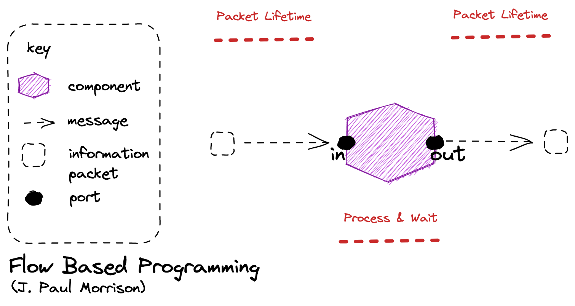
Node Lifetime: In flow base programming the a node can remain running whilst there is work on an input queue, can can suspend instead of terminate if there is no work on its connector.

Slide 84
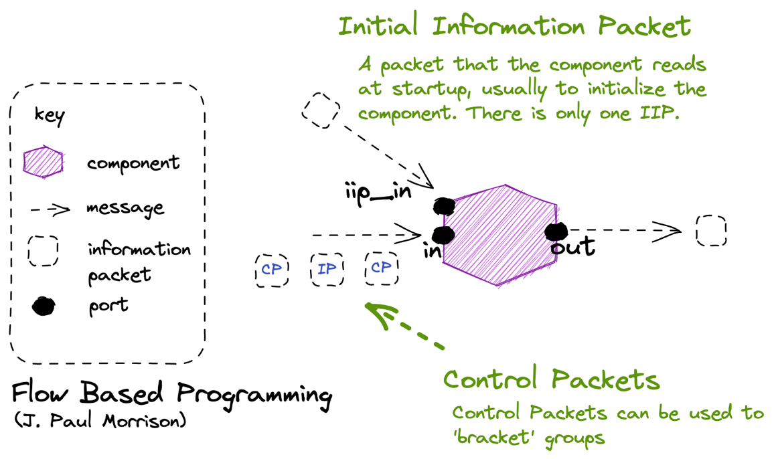
Notes:
MQTT Retained Messages are a way of emulating this IIP idea.

Slide 85
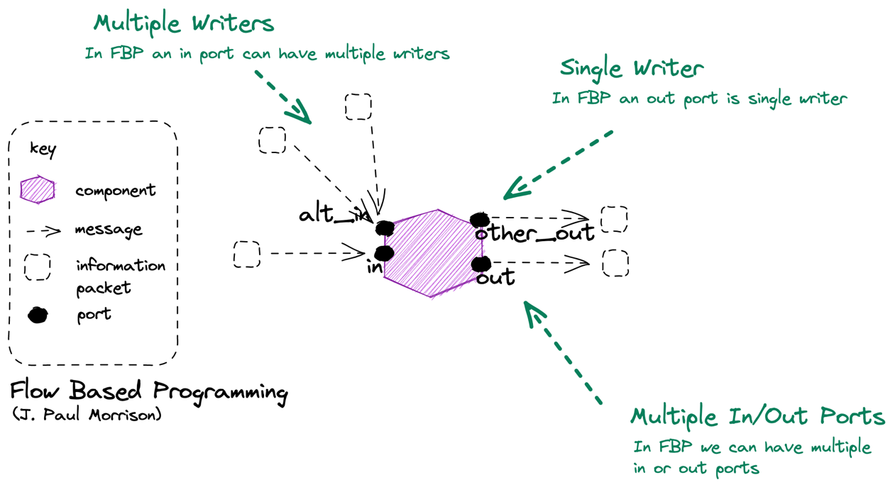
Capacity: In flow-based programming a component can test to see if it can send to out, and if not decide whether to halt or ignore.

Slide 86
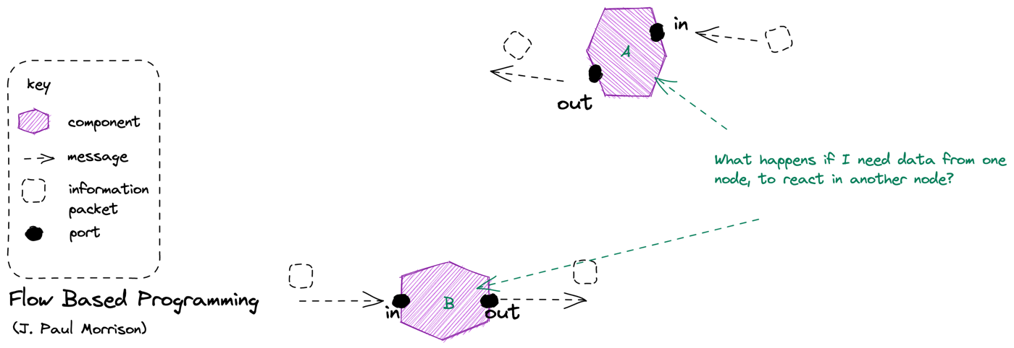

Slide 87
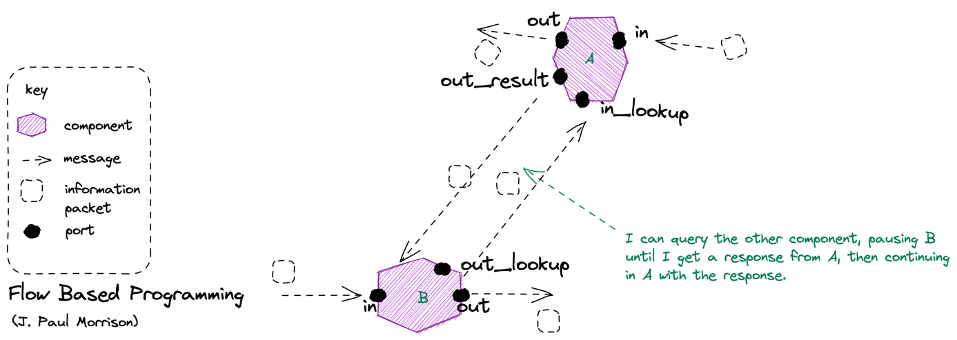
Walk of Shame: The trouble is that we may keep asking, so it makes sense to cache this somehow.

Slide 88
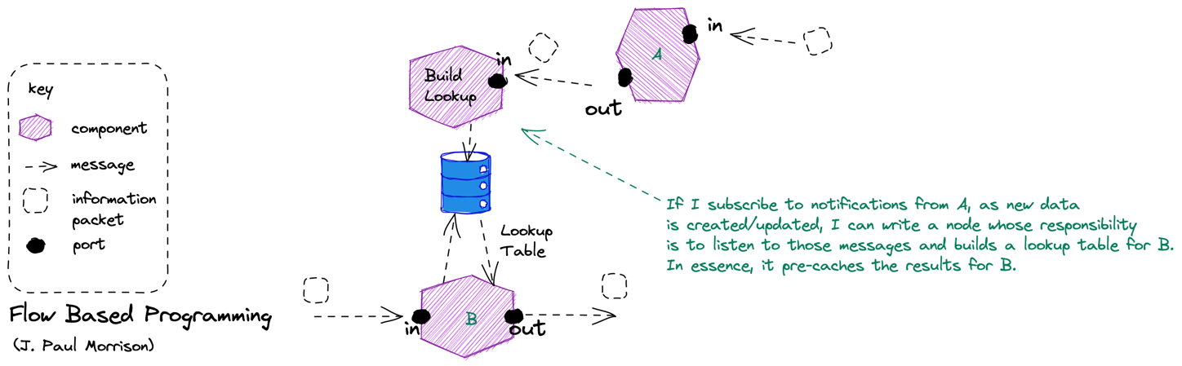

Slide 89
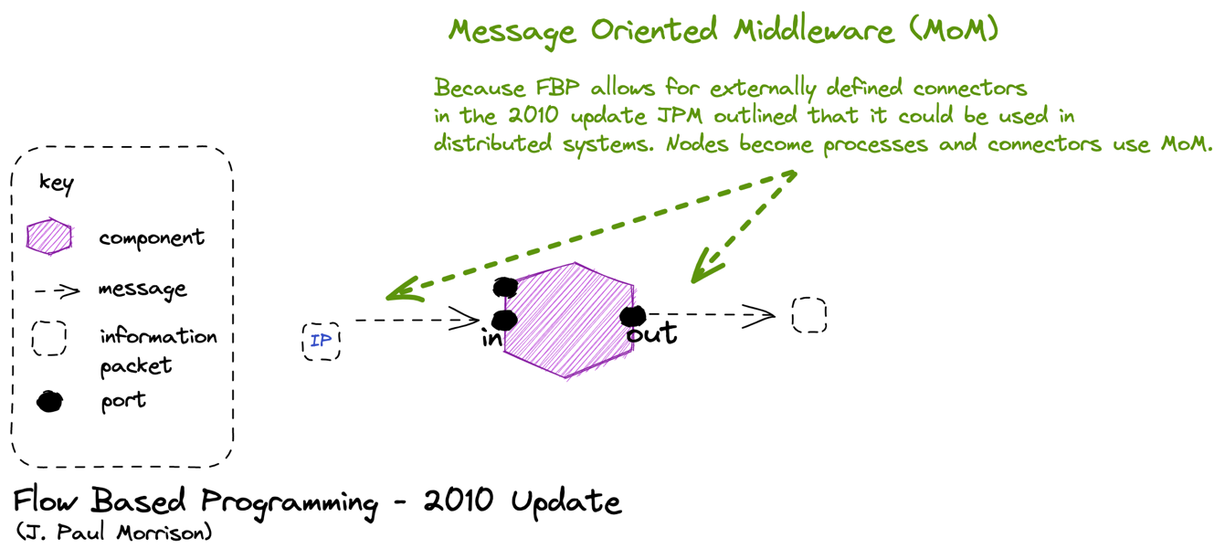

Slide 90
Example

Slide 91
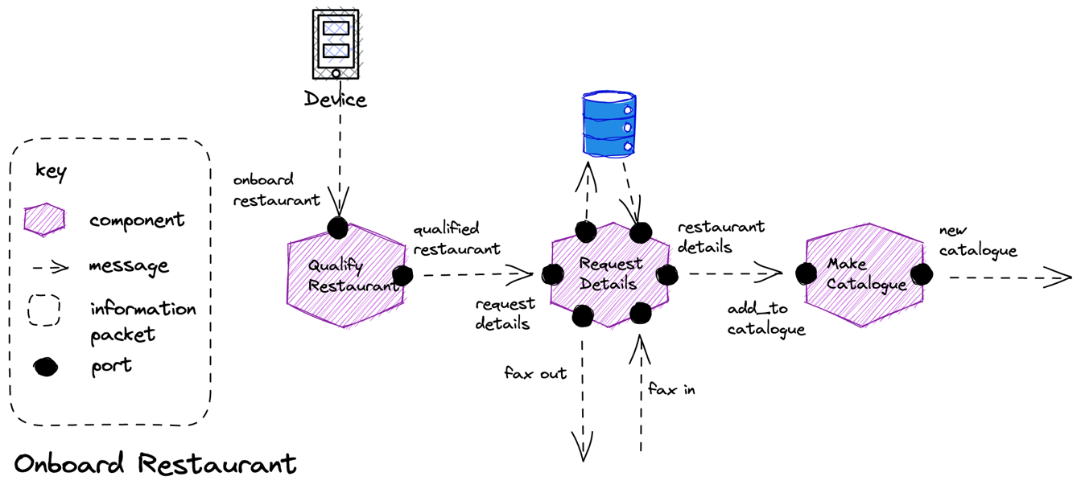
Storage: Request details may need storage to be reliable, it takes work from the request_details port, but cannot forward it to the restaurant_details port without waiting for an answer from fax_in. We store the state of the workflow in case we crash before receiving the response.
Correlation: To allow us to match the response to the saved state we use a correlation id. We send it on the ip to fax_out, and the restaurant includes it on the ip from fax_in. We use the ip to look up the workflow we stored.

Slide 92
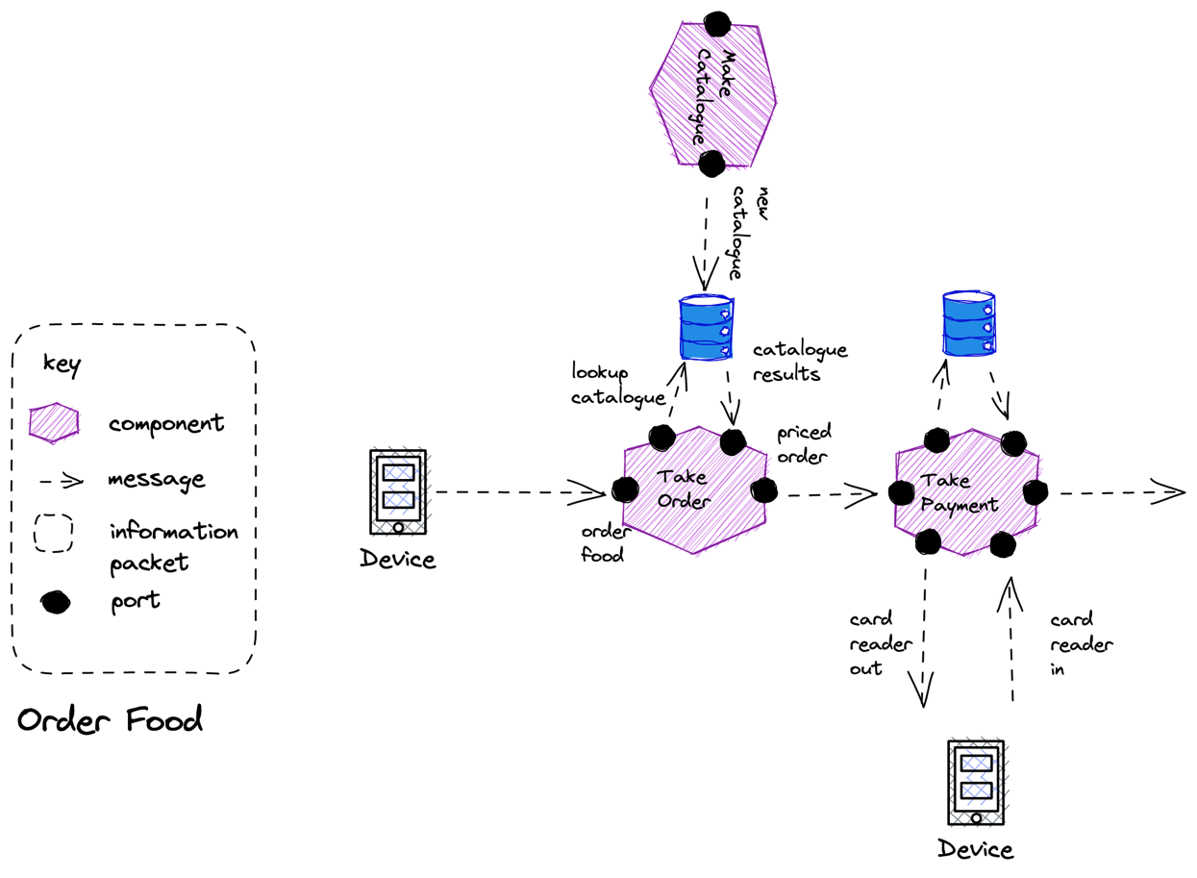
Lookup: We can build a store from IP raised from another component to act as a lookup table for information that we need to process a request.

Slide 93
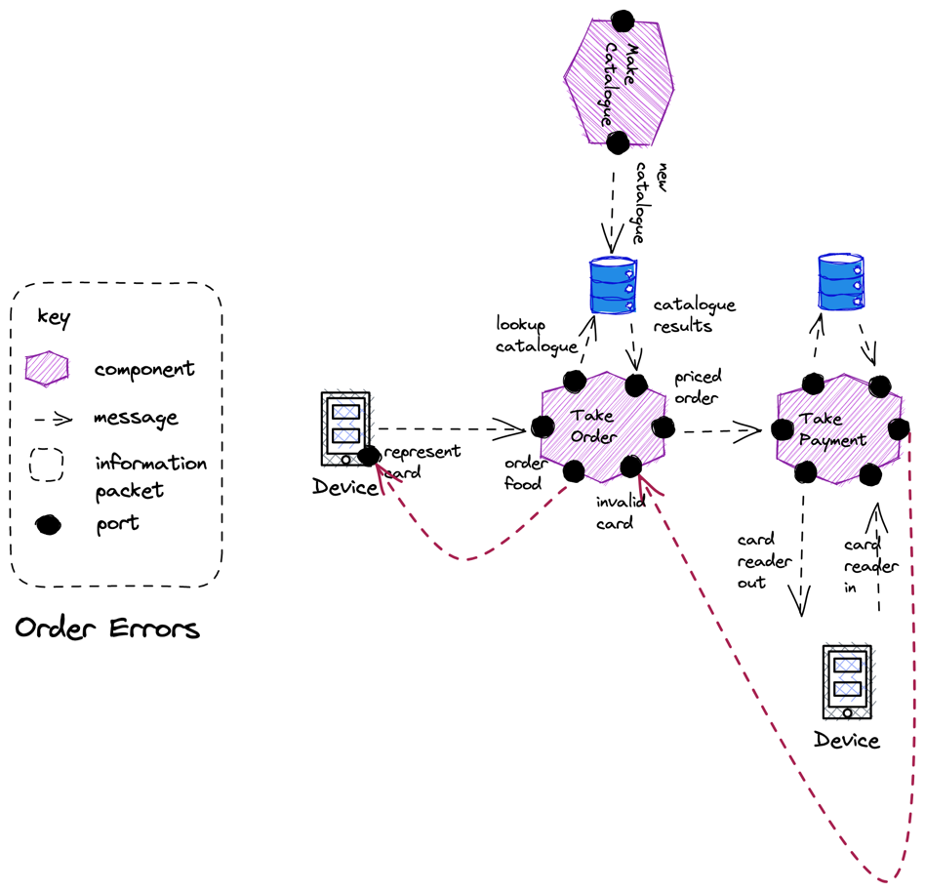

Slide 94
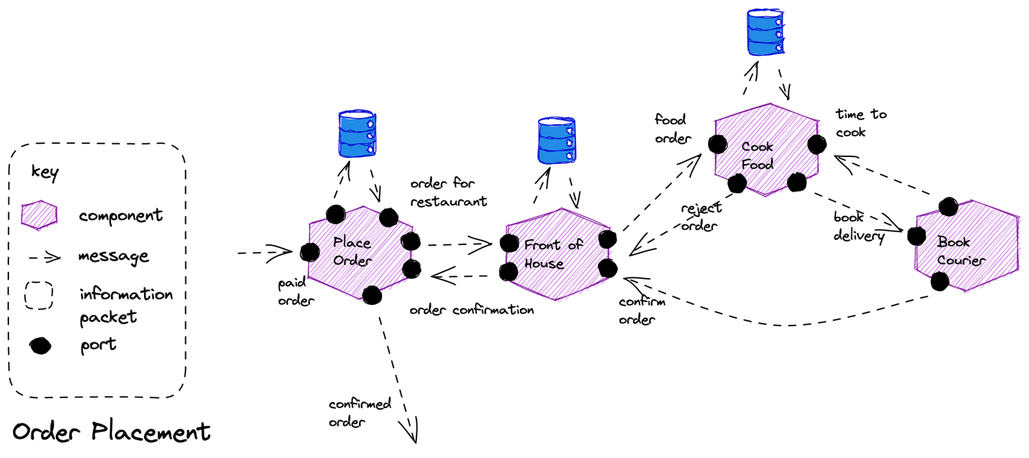

Slide 95
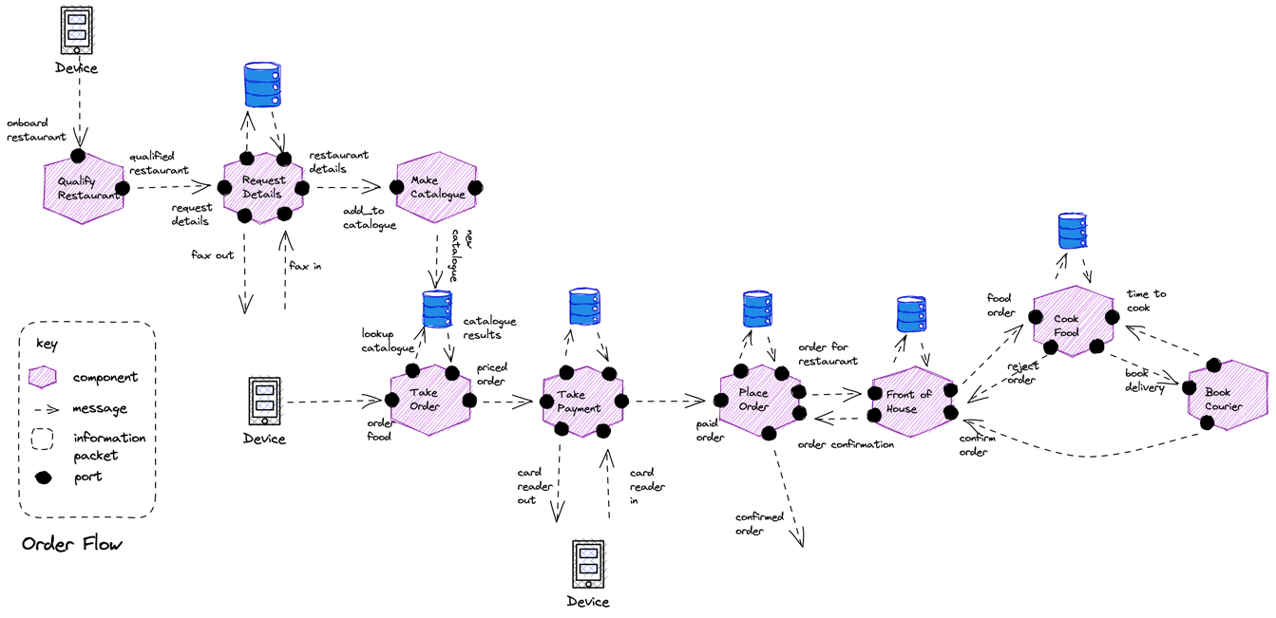

Slide 96
SOA Architectures

Slide 97
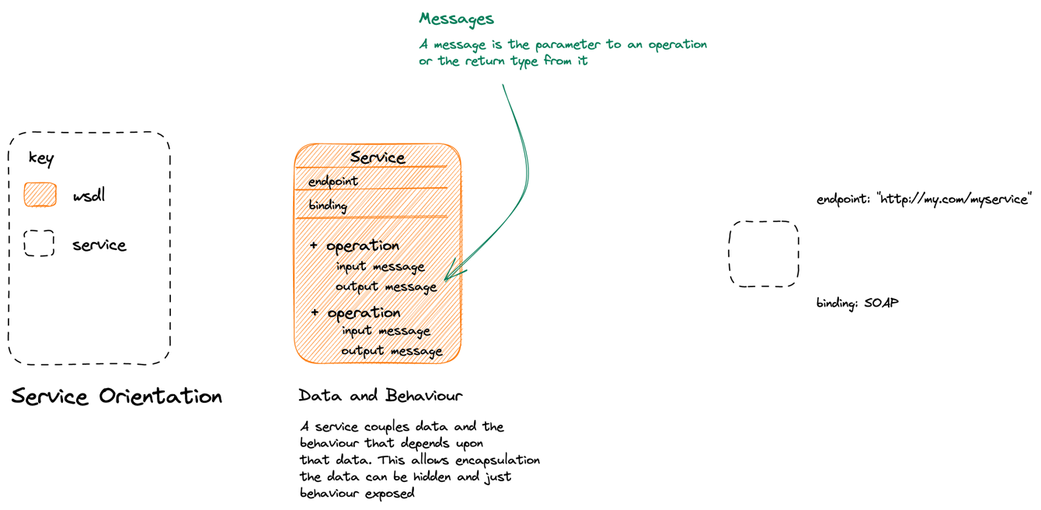
SOA & OO: SOA creates OO-like components, they encapsulate their data and expose behavior that is coupled to that data. This is the Web Services approach to services.
Notes:
SOA
====
SOA takes the idea of objects and uses it a macro scale
- A service has a role in the system, and attendant responsibilities which it exposes via various operations/behaviors.
- The service encapsulates the data that it is associated with those behaviors
- This is OO as an architectural principle.

Slide 98
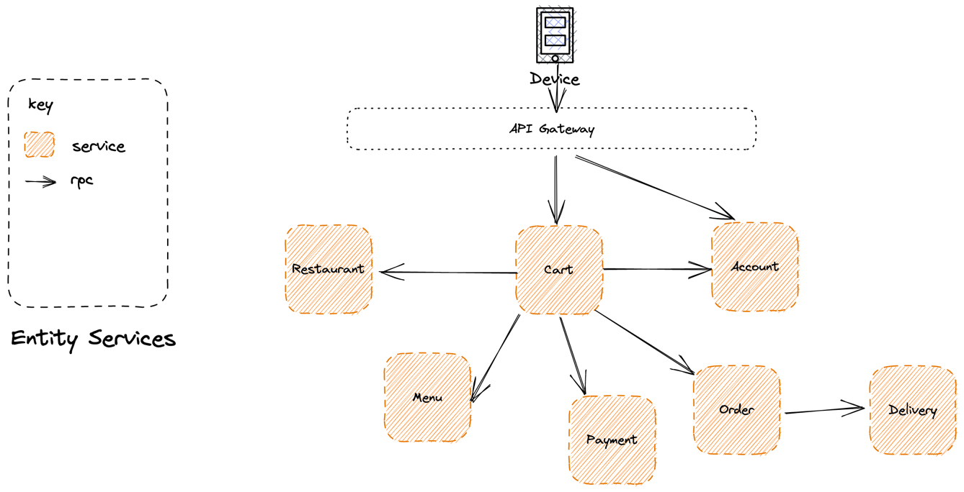
Feature Envy: Because domain logic needs to co-ordinate across these resources, it ends up either on the client, the API Gateway, or the Cart service and not in individual services. An anti-pattern.
SOA & OO: We expose significant resources and operations that you can perform upon them, often CRUD.
Notes:
Because we are making OO large, we have a tendency to use ”call and return” via a main method at our API gateway.
The problem with this is that we are effectively creating a distributed monolith because we are driving from our main method – the gateway.
Is there a better paradigm??

Slide 99
RPC is a synchronous conversation – both parties need to be active during the call
Faults Propagate: With a synchronous service, a fault propagates
Notes:
Typically we use RPC to replace the method calls, which tends to make us brittle as failure propogates

Slide 100
Reactive Architectures

Slide 101
The Reactive Manifesto
Published in September 2014
Author(s): Jonas Bonér (Erik Meijer, Martin Odersky, Greg Young, Martin Thompson, Roland Kuhn, James Ward and Guillaume Bort)
Defines an architectural style: Reactive Applications
Write applications that:
react to events: their event-driven nature enables the following qualities
react to load: focus on scalability rather than single-user performance
react to failure: resilient systems with the ability to recover at all levels
react to users: combine the above for an interactive user experience
Responsive: The system responds in a timely manner.
Resilient: The system stays responsive in the presence of failure.
Elastic: The system stays responsive under varying workload.
Message Driven: Rely on asynchronous message passing
https://www.reactivemanifesto.org/
Notes:
Not just the actor model!!! These ideas have seen expression beyond the actor model, and we would rather follow Helland in noting that many implementations are possible, including the actor model and we will talk about a few of them

Slide 102
Value
Responsive
Form
Elastic
Resilient
Means
Message Driven

Slide 103
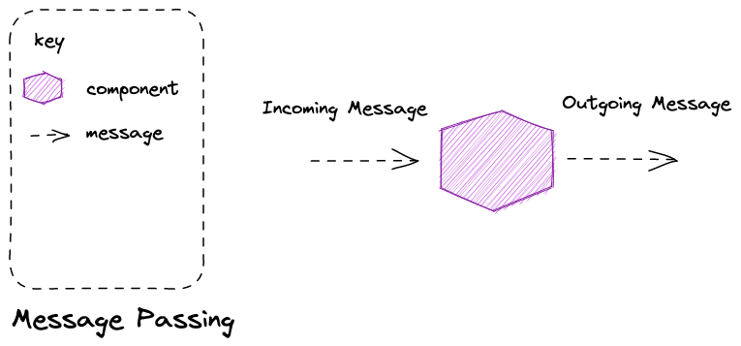
Message Passing is an asynchronous method of communication – both parties do not have to be simultaneously present for communication to occur, instead mail is delivered to ‘mailbox’ of some form for later retrieval.
Notes:
Message passing is a technique for invoking behavior (i.e., running a program) on a computer. In contrast to the traditional technique of calling a program by name, message passing uses an object model to distinguish the general function from the specific implementations. The invoking program sends a message and relies on the object to select and execute the appropriate code. The justifications for using an intermediate layer essentially falls into two categories: encapsulation and distribution.

Slide 104
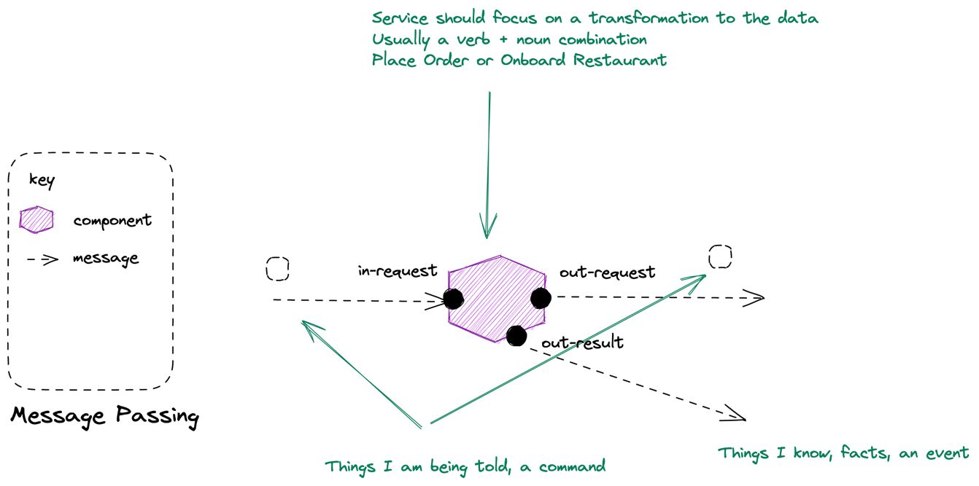
Notes:
Microservices are Reactive Architectures
===============================
Reactive Architectures derive from reactive programming not OO. “Everything flows”
Message passing is a technique for invoking behavior (i.e., running a program) on a computer. In contrast to the traditional technique of calling a program by name, message passing uses an object model to distinguish the general function from the specific implementations. The invoking program sends a message and relies on the object to select and execute the appropriate code. The justifications for using an intermediate layer essentially falls into two categories: encapsulation and distribution.
You can see how this means we are working in the reactive style: we separate data from behavior and activate a component in response to work being on a queue, process it, and then send an outgoing message

Slide 105
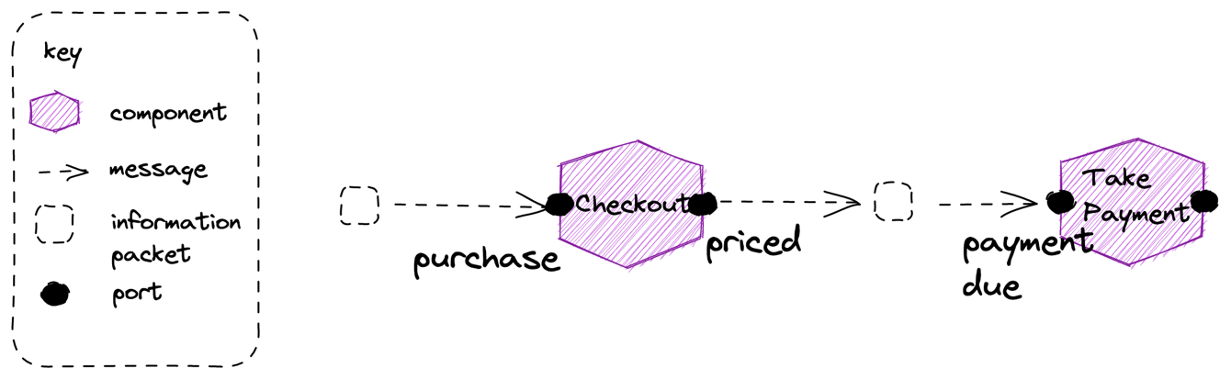
Coordinate Dataflow A reactive principle where we “orchestrate a continuous steady flow of information” focusing on division by behavior, not structure
Partitioning Partition to take advantage of parallelism in the system, tasks that could be done concurrently with each other
Notes:
Dataflow Reactive architectures inherit from dataflow programming – we conceive of our application as a graph of nodes that perform operations on data flowing through the system
Reactive shines in the creation of data-driven applications through the composition of components in workflows. Thinking in terms of dataflow, how the data flows through the system, what behavior it is triggering and where, and how components are causally related allows focusing on the behavior instead of the only on the structure. Orchestrate workflow and integration by letting components (or subsystems) subscribe to each other’s event streams, consuming on-demand the asynchronously published facts.

Slide 106
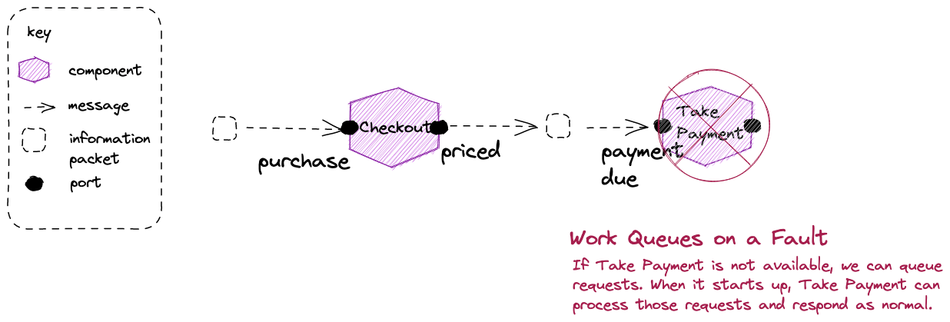
Bulkheads: In an asynchronous conversation a fault does not propagate back up the chain – we have a bulkhead that protects us against failure
Notes:
With asynchronous message passing the receiving object can be down or busy when the requesting object sends the message. Continuing the function call analogy, it is like a function call that returns immediately, without waiting for the called function to complete. Messages are sent to a queue where they are stored until the receiving process requests them. The receiving process processes its messages and sends results to a queue for pickup by the original process (or some designated next process).^{[3]}
Asynchronous messaging requires additional capabilities for storing and retransmitting data for systems that may not run concurrently, and are generally handled by an intermediary level of software (often called middleware); a common type being Message-oriented middleware (MOM).

Slide 107

Blocking Retry: Blocking Retry – when we keep trying to process a message, such as when we cannot connect to a DB and retry, creates backpressure as we slow consumption.
Notes:
Back-Pressure and Load-Shedding
If you have no buffers, or your buffers are full then something has to be sacrificed. Either we need to slow down the producer (back-pressure) or we need to discard data (load-shedding).
Back-pressure is the concept of the producer getting backwards pressure from the pipe it shoves data down, forcing it to slow down until the pressure alleviates. Back pressure is a good option when data loss is unacceptable and the extra latency is not an issue.

Slide 108

Notes:
Back-Pressure and Load-Shedding
If you have no buffers, or your buffers are full then something has to be sacrificed. Either we need to slow down the producer (back-pressure) or we need to discard data (load-shedding).
Load-shedding means we discard data in order to keep up. This can be a great option for metrics that are published at high velocity. We might receive a metric at a 1000 updates per second, but only need 10 per second in order to meet our SLA. We can even prioritize our load-shedding intelligently so we only discard less valuable data.

Slide 109


Slide 110


Slide 111


Slide 112
Putting It Together

Slide 113

Exercise material
Flow
Readme
Slides

Slide 114
Process Automation

Slide 115
What is a microservice?
SOA is focused on business processes. These processes are performed in different steps (also called activities or tasks) on different systems. The primary goal of a service is to represent a “natural” step of business functionality. That is, according to the domain for which it’s provided, a service should represent a self-contained functionality that corresponds to a real-world business activity.
Josuttis, Nicolai M.. SOA in Practice: The Art of Distributed System Design . O'Reilly Media. Kindle Edition.
Notes:
Whilst this is SOA advice, we are taking the view that microservices are just SOA 3.0, and as such, most of the best practice still applies
The key here is to understand that we want service alignment with a business process or activity. Whilst services offer us benefits such as fault-tolerance through isolation, that is not the thrust of this workstream. Instead this workstream is looking at how microservices improve our productivity, when we get alignment between a service and a business process.
We amplify this point in the next slide, which talks about the entity service anti-pattern

Slide 116
BPMN

Slide 117

A event is something that begins, ends or interrupts a flow
An end event terminates a flow
A start event begins a flow
In a sequence flow arrows show
The path of execution
A task is where work gets done in a flow
The end event throws a message
BPMN stands for Business Development Management and Notation. It is a visual language for diagramming a business processes in a clear, standardized and comprehensive way.

Slide 118

Gateway
Sequence Flow
Event
Start Event
End Event
Activity
- Task
- Sub-process
A BPMN diagram consists of a set of basic elements

Slide 119

Manual Task: waits for human completion of task (not via software)
Generic Task: basic task
Business Rule Task: executes a business rules engine
Service Task: uses a Service
Receive Task: waits to receive a message from another participant
Script Task: executes code
User Task: waits for human completion of task (via software)
Loop: this task loops
Send Task: sends a Message to another participant
Transaction: this task is a transaction
Task: an atomic activity. By implication, cannot be broken down further.

Slide 120

None Event: typically start or end, no defined trigger
Conditional Event: triggers when a conditional expression becomes true
Message Event: a message is received from another participant
Signal Event: a broadcast event triggers flows
Time Event: a date or time triggers a process
Parallel Event: multiple events required to trigger a sub-process
Escalation Event: triggers a sub-process to expedite completion of an activity
Cancel Event: used to trigger a sub-process with the abnormal termination of a transaction
Compensation Event: triggers a compensation sub-process
Event: something that happens within a flow: starts it, ends it, or interrupts it.

Slide 121

Exclusive: creates alternative paths based upon an expression, only one taken
Inclusive: creates alternative paths based upon an expression, may be taken in parallel
Parallel: split of join paths
Complex: a complex expression determines what paths are taken
Event: instead of an expression, an event determines what path is taken
Gateway: controls how sequence flow branches and converges

Slide 122
Sequence Flow
Message Flow
Connecting Object: connects activities

Slide 123
Workflow Patterns
Workflow Patterns: W.M.P. van der Aalst, A.H.M. ter Hofstede, B. Kiepuszewski, A.P. Barros, 2000
  5 Basic Patterns
  15 Advanced Patterns
Workflow Control Flow Patterns: A Revised View: W.M.P. van der Aalst, Nataliya Mulyar, Nick Russell, A.H.M. ter Hofstede, 2007
  23 New Patterns

Slide 124

Pattern 1 – Sequence
Description: One activity follows another.
BPMN: Connect two tasks with a sequence flow arrow.
Easy to model and execute.
    Example (Customer): Browse Pizza → Add Pizza to Basket.
Notes:
BPMN: Sequence: sequence flow

Slide 125

Pattern 2 – Parallel Split
Description: One path splits into two or more concurrent branches.
BPMN: Use a Parallel Gateway (+) to fork.
  Example (Pizza Shop): Assign Courier + Cook Pizza.
Notes:
BPMN: Parallel Split: parallel gateway (fork)

Slide 126

Pattern 3 – Synchronization (Join)
Description: Wait until multiple concurrent branches complete.
BPMN: Use a Parallel Gateway again to join.
  Example (Pizza Shop): Assign Courier + Cook Pizza.
Notes:
BPMN: Synchronization: parallel gateway (join)

Slide 127

Pattern 4 – Exclusive Choice
Description: Choose one path based on a condition.
BPMN: Use an Exclusive Gateway (X) with condition expressions.
  Example (Pizza Shop): Check Availability → Accept Order X Reject Order.
Notes:
BPMN: Exclusive Choice: exclusive gateway

Slide 128

Pattern 5 – Simple Merge
Description: Merge non-concurrent paths back into one.
BPMN: Use a converging sequence flow; no gateway is needed if no synchronization is required.
  Example: Multiple paths lead to Eat Pizza.
Notes:
Simple Merge: merge arrows or OR gateway

Slide 129

A Process describes a sequence or flow of Activities for carrying out work. In BPMN a Process is depicted as a graph of Flow Elements, a Sequence Flow, which is a set of Activities, Events, Gateways
A Process is an Orchestration:
The Sequence Flow represents control of a process
The token represents state associated with an instance
In implementation, generally a process orchestration lives within an address space i.e. is not distributed, either an embedded workflow or external process manager.

Slide 130
What is Orchestration?
Focused on a single participant’s perspective
Like writing your own script
Includes control flow, state, and decisions
All logic is local to the orchestrator
Often implemented via state machines or workflow engines.

Slide 131

A token represents an instance of a process
A token flows down the process; it is the state of the process for that instance
A token flows down the process; it is the state of the process for that instance

Slide 132

Pizza Example – BPMN Orchestration
Customer Pool
Notes:
We show the orchestration of the customer journey here. Later in the demo, we will just use HTTP calls to emulate this, but it's the same as making calls from web or mobile.
This is "in process" and we manage the flow of the session (token in BPMN terms) and its state through the flow.
We show where we wait on the receipt of a message though
If we debug this, we would pause, waiting for receipt of a message from another system. We can't see:
How values in the message we receive were set?
Why we do or don't receive a message?
For all of that we would need to go to the sender

Slide 133

Pizza Example – BPMN Orchestration
Pizza Shop Pool
Notes:
We show the orchestration of the pizza shop here.
This is "in process" and we manage the flow of the session (token in BPMN terms) and its state through the flow.
At points, we sent messages to act. We show these with the message icon in the ask
We show where we wait on the receipt of a message – beginning and end. We are initiated by a message from elsewhere
If we debug this, we would pause, waiting for receipt of a message from another system. We can't see:
How values in the message we receive were set?
Why we do or don't receive a message?
For all of that we would need to go to the sender
To debug the flow to the customer, we would need to set breakpoints in both.
That may be alright if we own both, but if these belong to different teams, we have to deploy their code too etc.

Slide 134

Pizza Example – BPMN Orchestration
Courier Pool
Notes:
We show the orchestration of the courier here.
This is "in process" and we manage the flow of the session (token in BPMN terms) and its state through the flow.
At points, we sent messages to act. We show these with the message icon in the ask
Note that we show where we wait on the receipt of a message
We are initiated by a message from elsewhere
If we debug this, we would pause, waiting for receipt of a message from another system. We can't see:
How values in the message we receive were set?
Why we do or don't receive a message?
For all of that we would need to go to the sender
To debug the flow to the pizza shop and customer, we would need to set breakpoints in all of them.
That may be alright if we own all of them, but if these belong to different teams, we have to deploy their code too etc.

Slide 135

Pizza Example – Pools and Lanes
Notes:
Multiple Pools: Pizza Shop, Courier, Customer App
Add message flows:
App → Pizza Shop: Order
Pizza Shop → Courier: Pickup request
Courier → Pizza Shop: Ready
Pizza Shop → Courier: Pizza is ready
We want to link the two processes, that is, to examine the interaction of customer and delivery service from a neutral perspective. We can try to model this interaction by means of a pool and lanes as in figure 2.99, but it doesn’t work well: There are tasks and events that reference interaction within the pool —waiting for the delivery, for instance, or collecting the money. Other tasks are carried out by roles oblivious to their partners, such as baking the pizza and eating the pizza. It is impossible to differentiate the two visually. Strictly speaking, the diagram is not semantically correct because message events always refer to messages received by the process from outside, and that’s not the case here.

Slide 136
A Collaboration is where we have multiple participants.
The message exchange between participants in a Collaboration is a Choreography
- In implementation, generally, a choreography is the flow of messages between participants. Within each orchestrated process, there are message events that are caught or raised
- But Processes react to what happens in the Choreography, no one owns it (it does not have its own tokens or state)

Slide 137
What is Collaboration
Focused on how participants interact
Interaction might be within a workflow engine.
  But this creates coupling, and both participants must run in the workflow engine.
Interaction might be via an API
  From an event-driven perspective, we are most interested in this model.

Slide 138
A Pool is participant in a collaboration
- A participant can be a role or an organization
Not required for the Main Internal Pool => modeler's own organization
Required for other organization's processes
A Lane distinguishes sequences of Activities in the Pool
White Box - can see process; Black Box - cannot see process
Activities within the Pool organised by sequence flow

Slide 139

Pizza Shop Collaboration

Slide 140

A Choreography describes a sequence or flow of Activities between two different participants. In BPMN a Choreography is depicted as a graph of Flow Elements, a Message Flow, which is a set of Activities, Events, Gateways
A Conversation is a logical association of messages that can all be correlated
- Correlation Keys are used to associate messages that form part of the same Conversation
- This may be existing message data
- The first task in a conversation MUST populate the conversation id

Slide 141
What is Choreography?
Focused on interactions across multiple participants
Like describing a dance, no single owner of the flow.
Defines who talks to whom, in what order
No centralized control
Cannot access shared internal data/state

Slide 142

Pizza Example - BPMN Choreography
Pizza Order Choreography
Notes:
Event this simple interaction results in a set of messages that flow between the participants.
This is the choreography, which shows the flow of messages between these activities:
Choreography is what happens when an application manages the flow i.e. has state for each instance of the flow that it tracks. Choreography is what happens "between".
Because this happens between, it has no explicit "owner". Who owns any part of this choreography?
If we want to understand our flow, it goes blind when it leaves our application, or our workflow engine =>? What is happening.
The problem here is the "event horizon" for you. You understand your workflow – it's in your code but debugging it becomes hard because at times, nothing happens that is supposed to and you struggle to know why.

Slide 143
Messaging and Eventing
A common notion within EDA:
  Messaging (commands) is orchestration; Eventing is choreography
It is not a helpful rule.
An orchestration is a sequence, with attendant session state [token]
  Frequently, it is not distributed and is within an executable process
  A routing slip is a distributed orchestration that utilizes message attributes as the engine for application state.
Choreography is the flow of control and information between orchestrations.
  Frequently, it is out of process.
  Can use messaging or eventing as required.

Slide 144
Event Chaining
A sensible balance of orchestrated bounded contexts and choreography between will reduce event chaining.
However, Event Pinball can still be a problem between orchestrated services.
In-Out (or Robust In-Only)
  Use of In-* patterns with explicit transfer of control reduces the “pinball effect” in choreography
  Creates causality in workflows by awaiting a response; you don’t send an event, and wait for a response, you send a command and wait for a response.
Out-Only
  Often better at the termination of a workflow, when the work is done, or to broadcast intermediate states with no expectation of response.

Slide 145
Allocating Responsibility for Collaborations
Commands/Messaging – Transfer of Control/Data.
  Typically, this involves delegating responsibility for part of a workflow.
  In-Out. Expected to Return
  In-Only. Not Expected to Return. But May on Error (Robust In-Only).
Events – Communicate the Outcome of a Workflow
  Typically, a workflow is complete or a milestone is broadcast for observation.
  Out-Only. No Expected Return.
Workflow code is Glue.
  Glue does not execute the domain; it is not the behaviour
  Instead, glue calls something that has the behaviour

Slide 146
Orchestration vs. Choreography Summary
Aspect | Orchestration | Choreography
Control | Centralized (one participant) | Decentralized (shared)
BPMN Shape | Inside a Pool | Between Pools
Perspective | One party’s process | Multi-party message exchange
Data Access | Internal | Shared messages
Execution Tool | API calls, Handlers, Workflow engine | Messaging protocol
Example | Pizza Shop coordinates cook + courier | Customer + Shop + Courier interact
Notes:
Implementation paths depend on model type
Helps decide between:
Embedded logic (orchestration)
API contracts/events (choreography)
Clear boundaries = better automation decisions
Clearer responsibility division between messaging and eventing

Slide 147
Durable Execution

Slide 148
Durable Execution
Long-running processes must:
  Survive restarts
  Handle retries and failures
  Resume after waiting (e.g., waiting for payment or a courier)
Durable execution = we persist activity state to indicate which steps in a sequence have been completed, when we are awaiting an event etc.

Slide 149
Activities and Resources
Broadly, a software component manages activities and resources [Pat Helland].
  Resources: domain concepts we manage, like restaurants, couriers, and customers.
  Activities: one or more sequences for our interaction with our resources.
  In response to the token moving through the sequence we update resources, and the activity to indicate our progress through the sequence.
The implementation question is: where does our activity state live, and who updates it?

Slide 150
:cashier
In response to a trigger, we orchestrate the Activities (usually Task) in the flow updating those and Resources resources that we own.
1.2*: get pricing details()
:pricer
Waiting for Response
1.3*: item price()
Our workflow has to store the state associated with the token – where are we in the flow?
1.4*: take payment()
:payment provider
There is a choreography - the messages that we exchange with other participants who run their own flows in response
Waiting for Response
1.5*: payment taken()
Activity. Usually the task we need to perform. Most frequently a service task – our workflow engine just contains glue code that calls the domain logic internally, or messages another application. Might be a framework, might be bespoke state machine or pipes and filters.
Resources. Code and data used to manage shared items coordinated across multiple activities such as widgets in inventory or space on a truck needed for a shipment. Our domain model.
Notes:
“To track relationships and the messages received, each entity within the scale-agnostic application must somehow remember state information about its partners. It must capture this state on a partner-by-partner basis. Let's name this state an activity. See figure 6. Each entity may have many activities if it interacts with many other entities. Activities track the interactions with each partner.”

Slide 151
Handlers + Activity State Updates
Handlers process events (change resources) and update activity state.
Activity state is often implicit, such as within an aggregate.
Durable because the state is stored (e.g., database), but the control flow is implicit
Great for simple workflows, but logic becomes scattered across handlers
Relies on guaranteed delivery to store work for retry unless ack’d
Relies on Transactional Messaging (Outbox)
Becomes complex once we introduce retry, circuit breakers & compensation
Becomes complex once we have split, join, choice, merge (not a sequence)
Notes:
Purpose: Show the baseline automation.
Pizza shop code example:
public class OrderReceivedHandler : IHandle<OrderReceived>
{
public Task Handle(OrderReceived msg) {
// Lookup order
// Set state = Preparing
return Task.CompletedTask;
}
}
Handlers process events, update persistent state
Durable because state is stored (e.g., database), but control flow is implicit
Great for simple workflows — but logic becomes scattered across handlers

Slide 152


Slide 153
(Fault) Handlers + Activity State Updates
How do we handle compensation flows?
  May retry the handler, and only if it fails X times, run the fallback.
  On fault, choose to run a “fallback handler” – initiates compensating action.
  Typically, needs to reverse actions that have occurred so far; write an “undo” for each “do”.
  Typically, a straightforward approach is to send a fault message back upstream and undo it upon receipt.
Fault Message
  For reliable In-Only, a fault channel is required, which is only used for compensation.
  For In-Out, the message sent to the response channel should indicate fault, not success.
Notes:
The Saga pattern describes long-running transactions in distributed systems. The main idea is simple: when you can’t roll back tasks, you undo them. The name Saga refers back to a paper written in the 1980s about long-lived transactions in databases. BPMN supports this through compensation events, which can link tasks with their undo tasks. Figure 9-12 shows this for the onboarding example, given that errors can happen at any time and all affected tasks need to be properly cleaned up. A workflow engine will make sure to execute all the necessary undo actions.
Ruecker, Bernd. Practical Process Automation: Orchestration and Integration in Microservices and Cloud Native Architectures (pp. 262-263). (Function). Kindle Edition.

Slide 154
State Machine + Activity State Updates
When the interaction of Handlers becomes complex, we can make the activity explicit.
  A State Machine represents the activity and triggers actions in response to transitions.
    Transitions are caused by receiving a message.
    The handler receives a message and loads the corresponding state machine associated with the conversation ID.
    This triggers the transition denoted by the receipt of the message; the state machine runs any code associated with that transition.
Save the new state of the state machine and ack the message.
Notes:
Define states: Received → Preparing → Ready → OutForDelivery → Delivered
Transitions triggered by events or commands
Code: state pattern, switch statements, or library-based (e.g., Stateless)
Durable via persisted state and event log
Benefits:
Predictable
Easier to visualize and test
Avoids duplication across handlers
Drawback: No concurrency or waiting logic

Slide 155


Slide 156
(Fault) State Machine + Activity State Updates
How do we handle compensation flows?
  May retry the transition, and only if it fails X times, run the compensation.
  On fault, transition to a faulted state and initiate compensating flow to the “safe” state.
  Typically, this involves reversing actions that have occurred so far; write an “undo” for each “do”.
  Requires durable execution – if we fault partway through, on restart, we can resume.
The “saga” pattern, when used by messaging frameworks, is typically a state machine.
  In essence, guarantees that on a fault, the state machine will transition back to “safe”
  Implementations run all fault transitions to safe before ack fault message.
Notes:
The Saga pattern describes long-running transactions in distributed systems. The main idea is simple: when you can’t roll back tasks, you undo them. The name Saga refers back to a paper written in the 1980s about long-lived transactions in databases. BPMN supports this through compensation events, which can link tasks with their undo tasks. Figure 9-12 shows this for the onboarding example, given that errors can happen at any time and all affected tasks need to be properly cleaned up. A workflow engine will make sure to execute all the necessary undo actions.
Ruecker, Bernd. Practical Process Automation: Orchestration and Integration in Microservices and Cloud Native Architectures (pp. 262-263). (Function). Kindle Edition.

Slide 157
Routing Slip + Activity State Updates
If we want to distribute steps in the sequence, we need to transport the activity state in the message.
A routing slip is an envelope that indicates the activity state (next step, context, etc.).
Think of it as “Message As the Engine of Application State”
The handler updates the state when work is done and forwards according to the routing slip. Then acks.
Complex if “next” is dynamic routing, as the code must understand how to execute.
Complex because you are distributing the steps, hard to observe [Otel]

Slide 158
(Fault) Routing Slip + Activity State Updates
How do we handle compensation flows?
Next is now the fault next, from this step; what do we need to reverse.
Context is “faulted”
The handler updates the state when work is done and forwards according to the routing slip. Then acks.

Slide 159
Workflow Engines + Activity State Updates
When we want more than just state transitions (split, join, merge, choice, etc.), use a workflow engine.
  A workflow engine explicitly models a sequence of activities and gateways.
    May directly support BPMN (or proprietary language); allows visual modelling.
    A step receives the token. The step is glue code: it invokes the action in the domain, calls another service, and sends a message.
    A step may wait for an event or a timer to signal that execution should resume. It may be the handler equivalent, or it may be triggered by the handler calling the engine.
    A job scheduler provides durable execution. Typically, any instance can resume a paused job – distributed.
Notes:
Purpose: Add expressiveness and infrastructure.
External orchestrator runs the process: Temporal, Camunda, Azure Logic Apps, AWS Step Functions
Supports:
Wait states (e.g., await PizzaReady)
Parallel branches
Timeouts and retries
Visual modeling
Durable by design: execution state + workflow history stored
Suited to complex, distributed systems
Example:
StartCookingPizza
WaitForPizzaReady
DispatchCourier
WaitForPickup
MarkAsDelivered

Slide 160
(Fault) Workflow Engines + Activity State Updates
How do we handle compensation flows?
    Is the error a business error or a technical error?
  A known business error (i.e. card declined) is usually modelled explicitly as a branch via a gateway.
    A retry frequently handles technical faults. If the retry fails and a catch is present, then a fallback runs. If there is no catch, then either the workflow rolls back to the last wait state or terminates.
Notes:
Purpose: Add expressiveness and infrastructure.
External orchestrator runs the process: Temporal, Camunda, Azure Logic Apps, AWS Step Functions
Supports:
Wait states (e.g., await PizzaReady)
Parallel branches
Timeouts and retries
Visual modeling
Durable by design: execution state + workflow history stored
Suited to complex, distributed systems
Example:
StartCookingPizza
WaitForPizzaReady
DispatchCourier
WaitForPickup
MarkAsDelivered

Slide 161
Embedded vs. External Workflow Engines
Embedded: The workflow runs in process and calls your code directly.
External: The workflow runs in its own process; it can execute code directly, but should favour calling services to get work done.

Slide 162
Workflow Engines: Lessons from SOA
SOA era favoured external workflow engines, Enterprise Service Buses (ESBs)
Business logic moved into the bus — tightly coupled, hard to test
Led to Guerilla SOA: reclaim domain logic into services, embrace simplicity
Notes:
External orchestration ≠ anti-pattern, but requires care
Strategies:
Keep core domain logic inside services
Workflow engine coordinates outcomes, not fine-grained steps
Consider choreography or local orchestration for autonomy

Slide 163
Smart Endpoints, Dumb Pipes
ESB products often include sophisticated facilities for message routing, choreography, transformation, and applying business rules. The microservice community favours an alternative approach: smart endpoints and dumb pipes.
https://martinfowler.com/articles/microservices.html#SmartEndpointsAndDumbPipes
Notes:
Microservices promote smart services and minimal messaging infrastructure.
External workflow engines risk anaemic services — all domain logic moves out.
Services become passive executors of workflow directives.

Slide 164
Embedded vs. External Workflow Engines
Favor embedded Workflow engines when the workflow is within a bounded context; everything between bounded contexts is choreography
Reserve external Workflow engines for orchestrating the flow between bounded contexts, when relying on choreography is too complex.

Slide 165
Implementing Workflow Patterns
Pattern | Handlers Only | State Machine | Workflow Engine
Sequence | Chain message handlers | State transitions (A→B→C) | Sequential steps
Parallel Split | Trigger multiple handlers | ⚠️ Complex coordination manually | Parallel branches with fork/join
Synchronization | Wait for multiple states | ⚠️ Hard to do without orchestration | Join after parallel branches
Compensation | Fallback Handler | Saga | Implicit
Exclusive Choice | Conditional in handler | State transition based on input | Conditional branching
Simple Merge | Trigger single follow-up | Re-entrant transition or rehydration | Multiple incoming flows, OR gateway

Slide 166
Putting it together

Slide 168
Storage: Request details may need storage to be reliable, it takes work from the request_details port, but cannot forward it to the restaurant_details port without waiting for an answer from fax_in. We store the state of the workflow in case we crash before receiving the response.
in-Only
In-Only
Out-Only
Messaging
Messaging
Eventing
Messaging
Messaging
In-Out
Correlation: To allow us to match the response to the saved state we use a correlation id. We send it on the ip to fax_out, and the restaurant includes it on the ip from fax_in. We use the ip to look up the workflow we stored.

Slide 170
Lookup: We can build a store from IP raised from another component to act as a lookup table for information that we need to process a request.
Eventing
Out-Only
In-Only
In-Only
Messaging
Messaging
Messaging
Messaging
In-Out

Slide 172
Messaging
Message Triggers
Fault
Message Triggers
Fault
Messaging

Slide 174
in-Out
in-Out
Messaging
Messaging
in-Only
Messaging
Messaging
Messaging
Messaging
in-Out
Messaging
Eventing
Eventing
Out-Only

Slide 177
Next Steps

Slide 178

Further Reading
https://jonasboner.com/resources/Reactive_Microservices_Architecture.pdf

Slide 179

Further Reading
https://processautomationbook.com/

Slide 180

Further Reading
https://serverlessland.com/event-driven-architecture/visuals

Slide 181

Further Reading
https://www.enterpriseintegrationpatterns.com/gregor.html

Slide 182
Q&A

